Slide 1


Slide 2
Airborne MAGNETIC SURVEYING
Overview

Slide 3
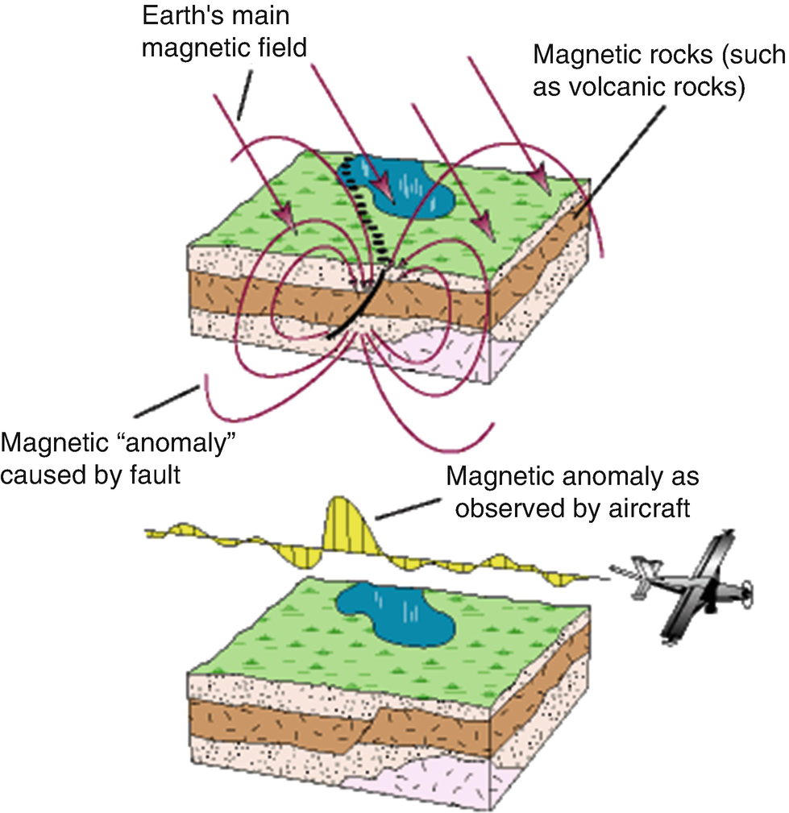
Want to measure:
Magnetic signature from Geological formations:
Measure the distortion in the earths Magnetic field.
- Aid interpretation
- Map Structures
- Detect anomalies
Must fly a grid pattern
Height attenuation
Terrain follow

Slide 4
Data Acquisition :
Collect 2D data:
- Fly a grid pattern
- closer line spacing=better resolution
Signal attenuation:
- Close to the magnetic source.
- Terrain follow

Slide 5
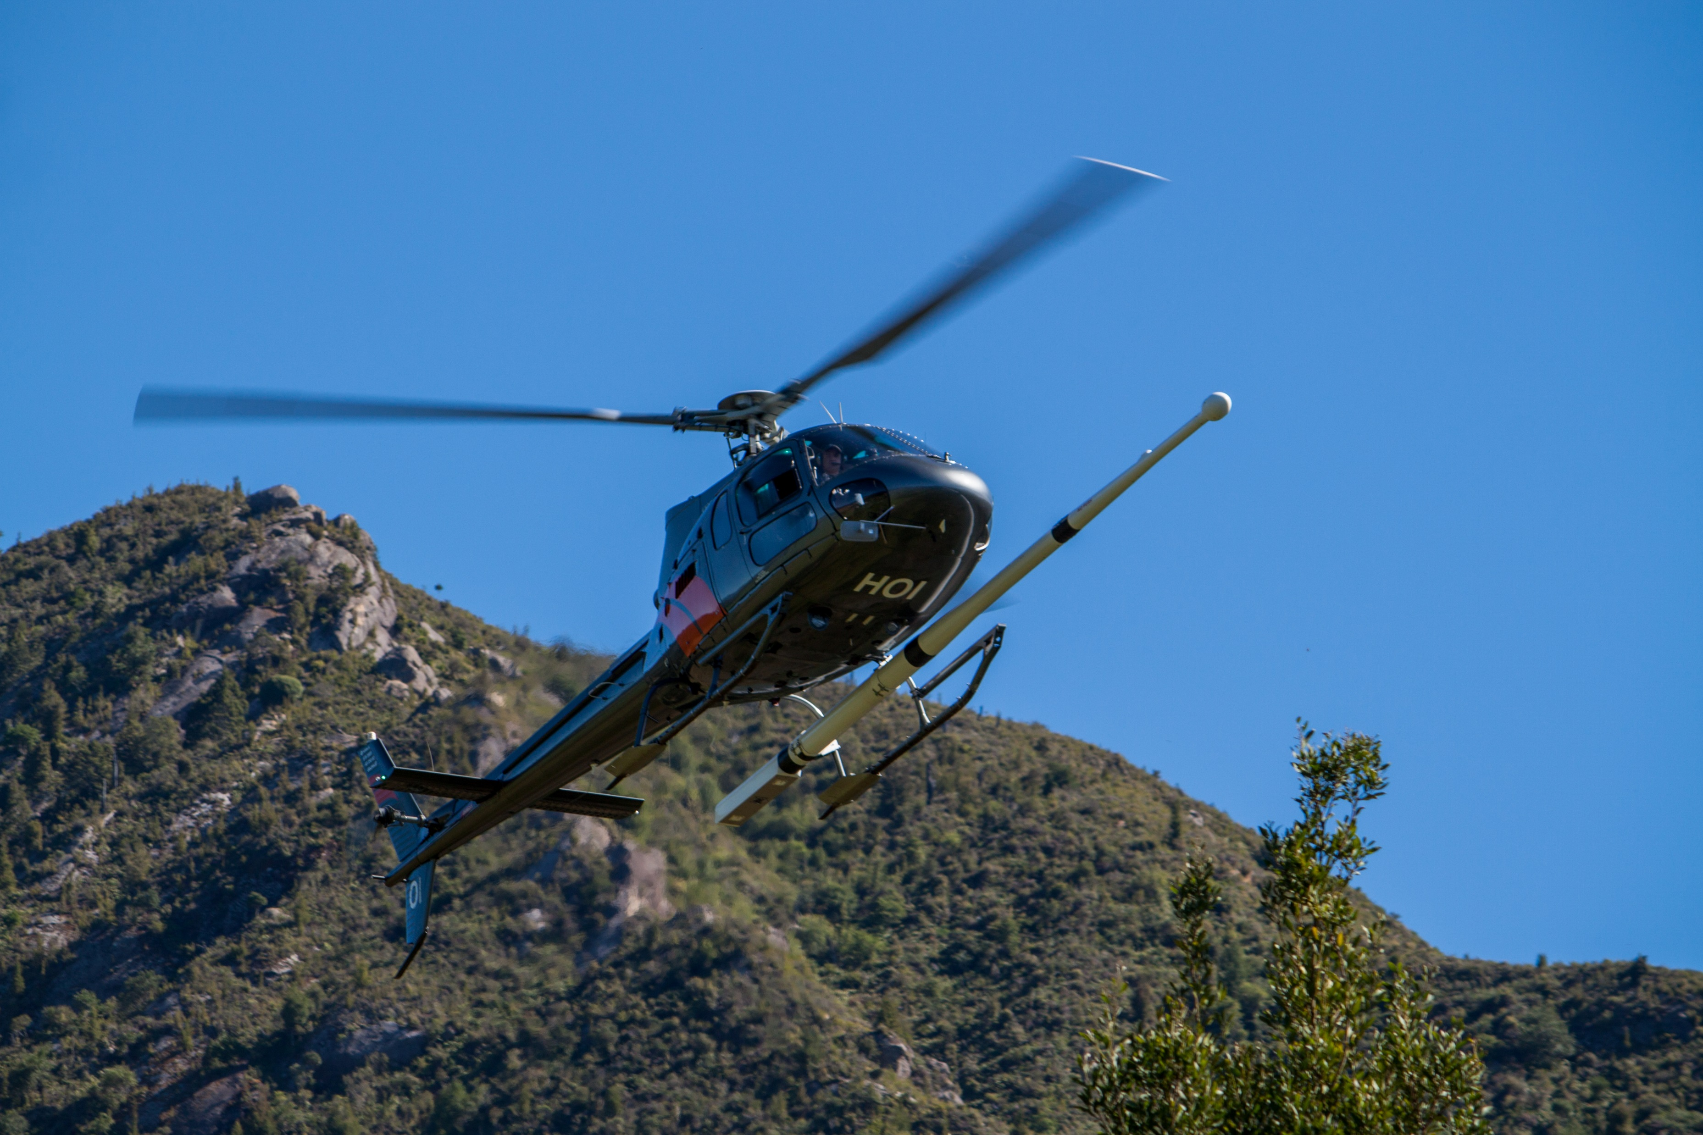
Traditional Survey aircraft:
Helicopter Systems:

Slide 6
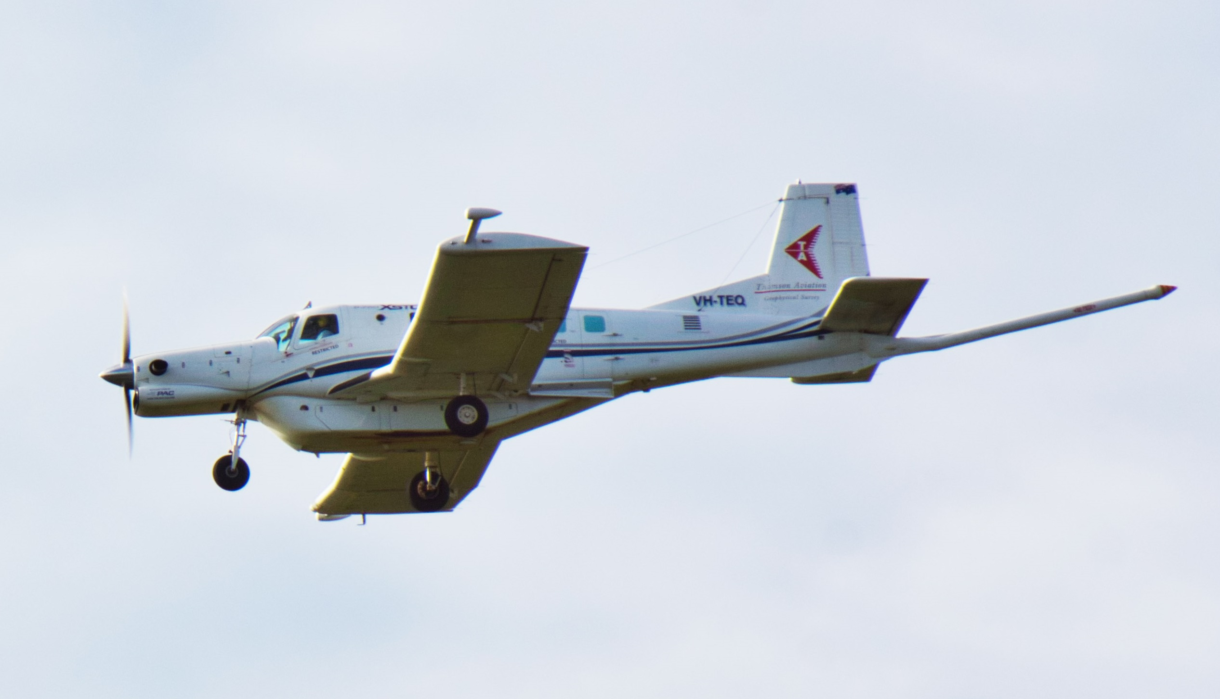
Traditional Survey aircraft:
Fixed Wing Systems:

Slide 7
Development of UAV magnetic survey systems:
Try to replicate Full sized aircraft with UAV:
Must Consider:
Magnetic Quality : sensitivity/ noise / interference
Survey area: Size, terrain, vegetation, access
UAV selection: performance, endurance, technology
Survey budget: $$$$$$
Constraints: Regulations, safety requirements, insurance, licensing.

Slide 8
UAV MAGNETIC SURVEYING
First round
of UAV Mag Development

Slide 9
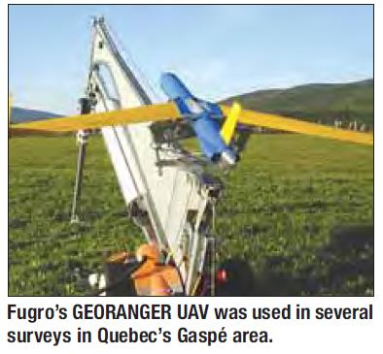
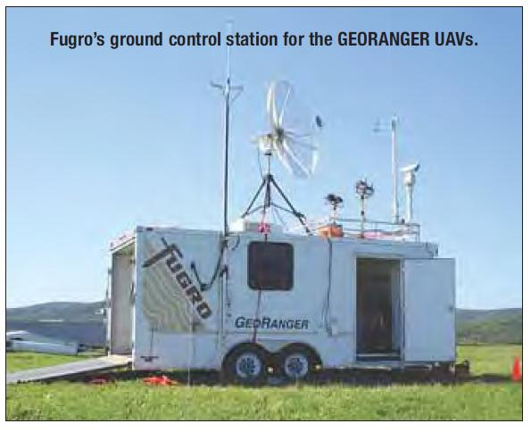
Development of UAV magnetic survey systems:
Early attempted Uav Mag Systems:
Fugro Airborne 1993 Georanger , 2006- Aerosonde

Slide 10
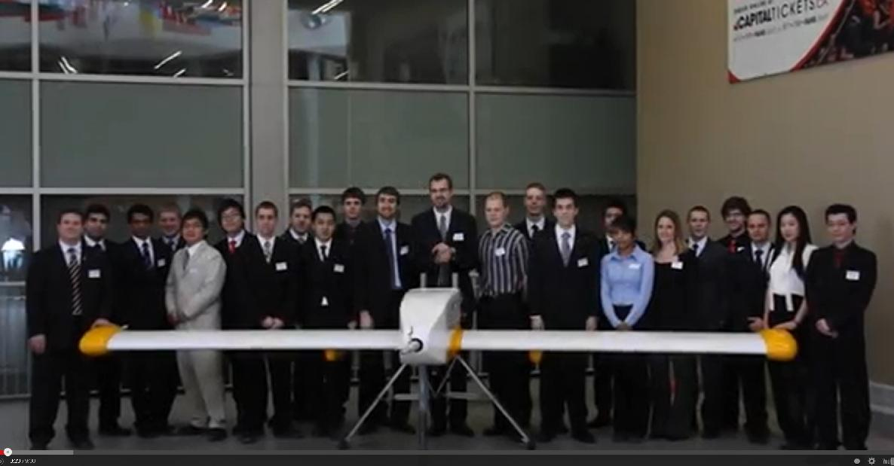
Development of UAV magnetic survey systems:
Early attempted Uav Mag Systems:
Sanders Geophysics & Columbia State University UAV: (2009 - 2014)

Slide 11
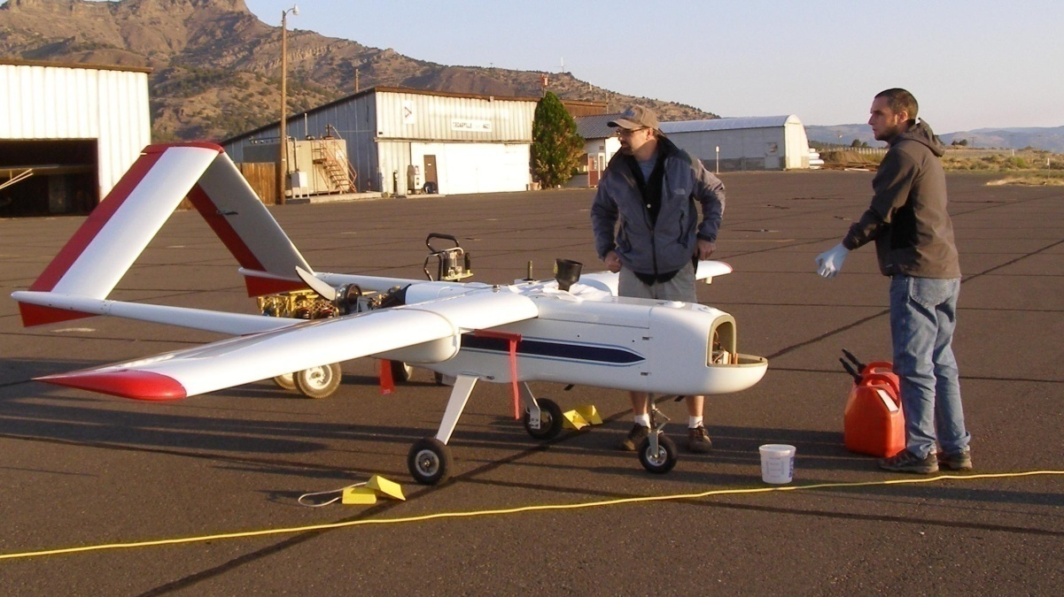
Development of UAV magnetic survey systems:
Early attempted Uav Mag Systems:
United States Geological Survey ( 2011 - 2013 )

Slide 12
Development of UAV magnetic survey systems:
Early attempted Uav Mag Systems:
China Geological Survey UAV Mag System: ( 2013 - ?

Slide 13
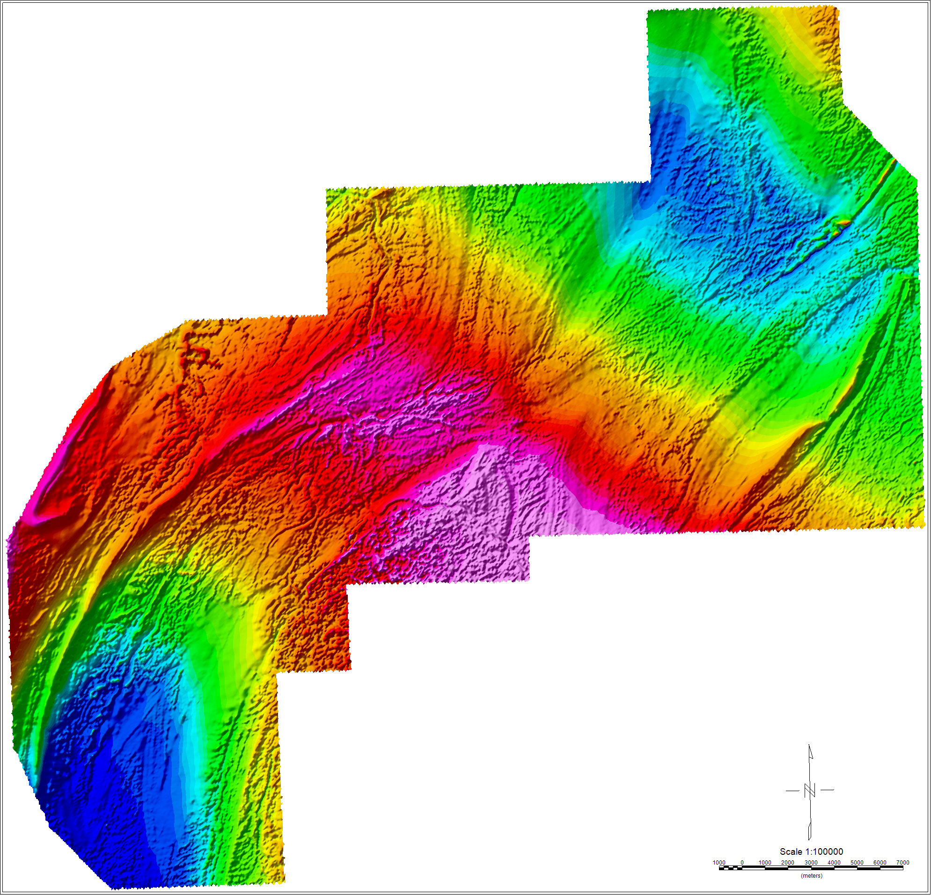
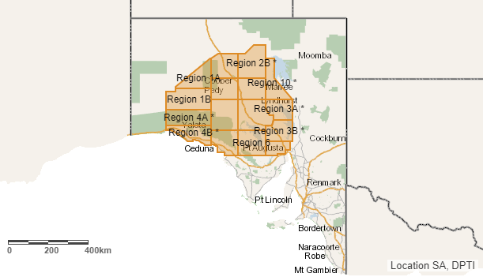
Attempting to do Large area surveys
Gawler-Craton survey in SA 1,800,000km

Slide 14
Development of UAV magnetic survey systems:
Try to replicate Full sized aircraft with UAV:
Corporate attempts: Our aims:
Magnetic resolution : High sensitivity Low Resolution
Survey area: Traditional Size Small survey Area
UAV selection: Military, Custom RC technology
Survey budget: High $$$$$$ very small $
Regulations: will overcome Disregard.

Slide 15
Major developments for the next phase of
UAV Mag Development:
Low cost Autopilot – APM1.1, Ardupilot/ Pixhawk
Custom Development Data acquisition system
Long range Data Links- RFD900
Digital long range Video Links
Multi Rotor technology- Hybrid Multirotor.
Relaxation of Licensing restrictions.

Slide 16
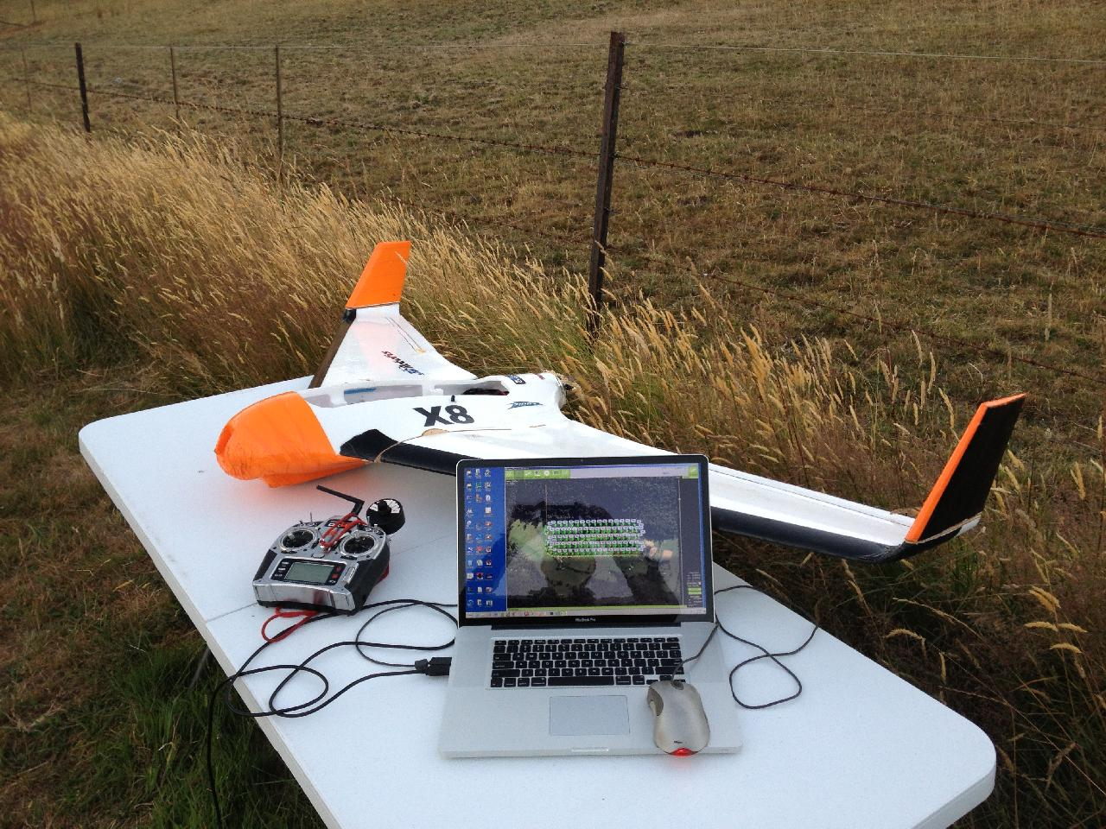
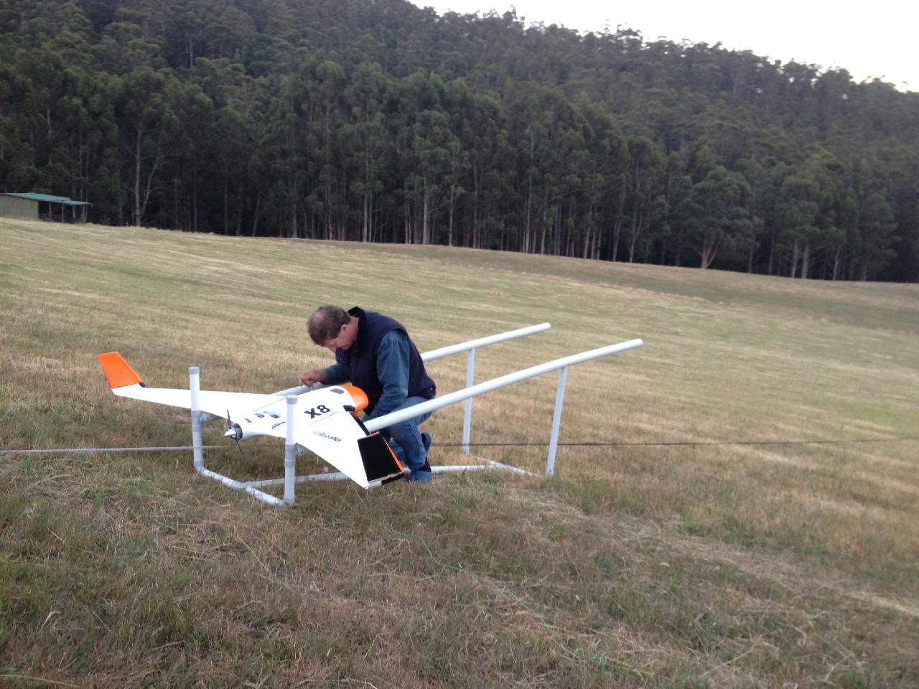
Development of UAV magnetic survey systems:
Early attempted Uav Mag Systems:
Rada Engineering UAV Mag System: ( 2013 ) electric X8

Slide 17
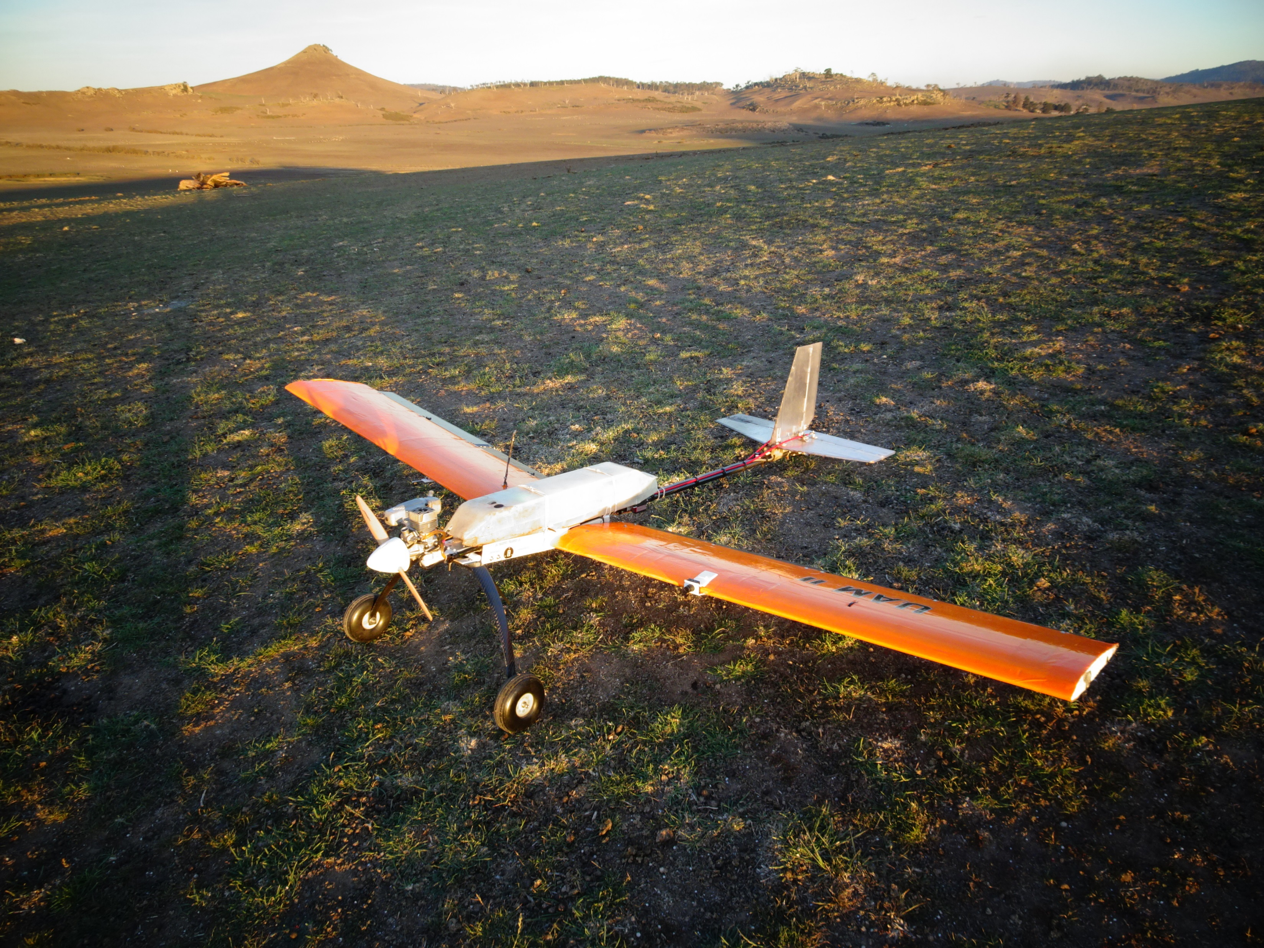
Development of UAV magnetic survey systems:
Early attempted Uav Mag Systems:
Custom Fixed Wing (petrol) : Rada engineering ( 2015-2017)
Wingspan 2.6 m
Endurance 1.5 hrs
Speed 70 km/h
Range: 100 km/ flight
Wind Tolerance: 20 km/h

Slide 18
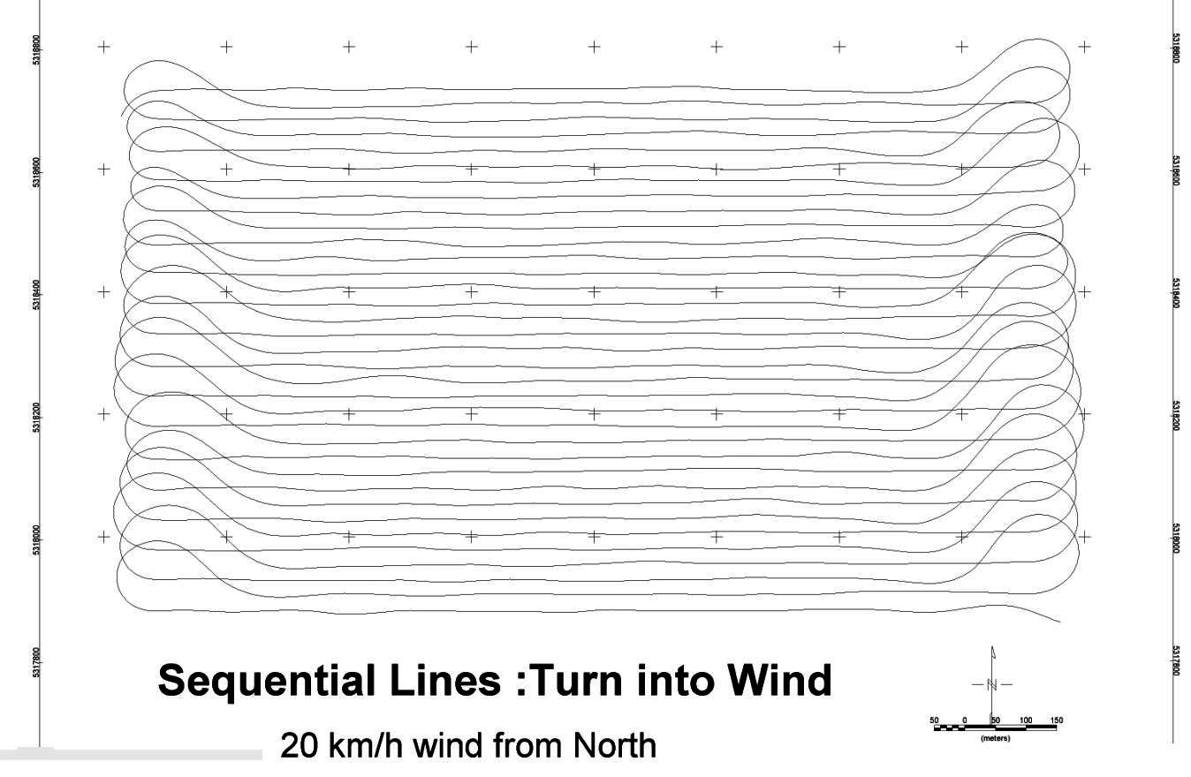
Example Flight path Flown:

Slide 19
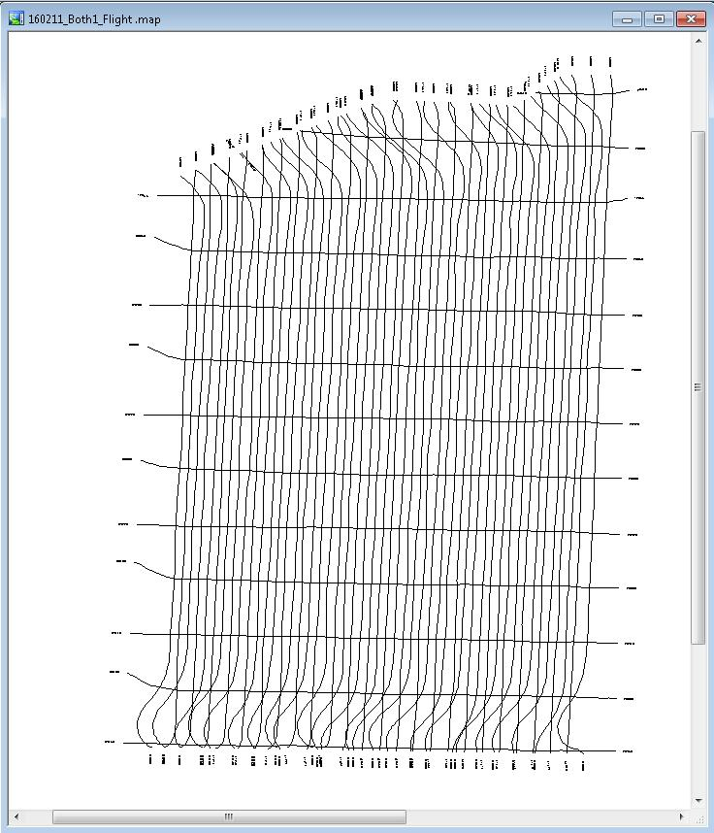
Flight Planning:
Customized Planning software
3D Terrain Following
Built in Survey Over fly
Flying height 30m AGL +
Line spacing 20 m +
Climb rate 20 deg
Fully Autonomous

Slide 20
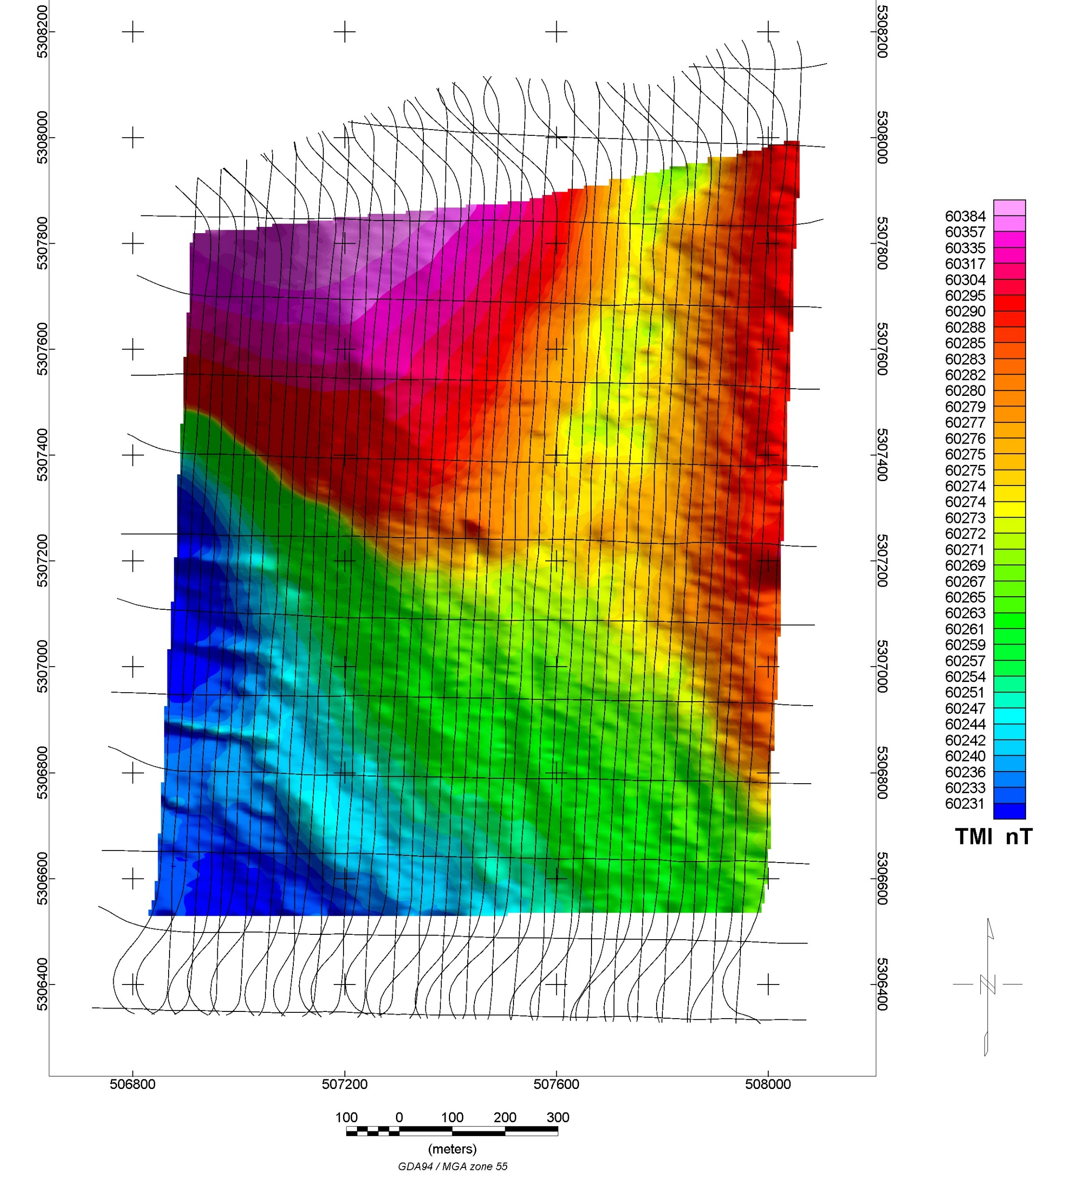
Total Magnetic Intensity Image
Line Spacing 30m
Flying Height 40m
Total Distance 120 km.

Slide 21
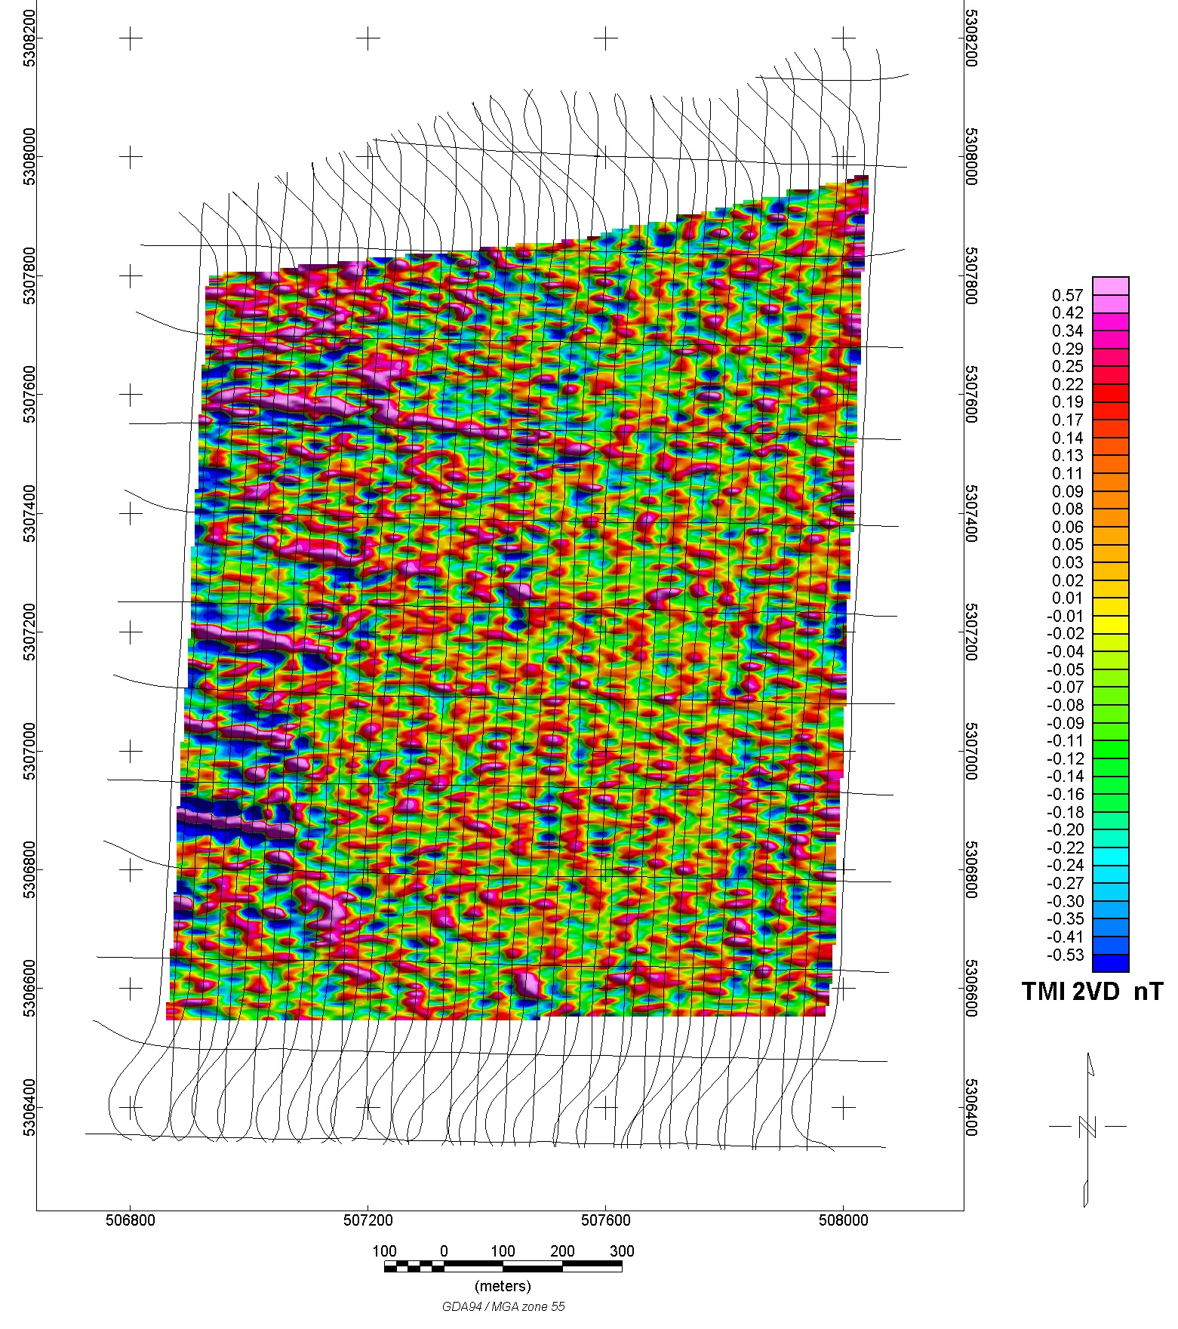
2VD Total Magnetic Intensity Image
Line Spacing 30m
Flying Height 40m
Total Distance 120 km.
Fence lines detected in 2VD. 0.5nT

Slide 22
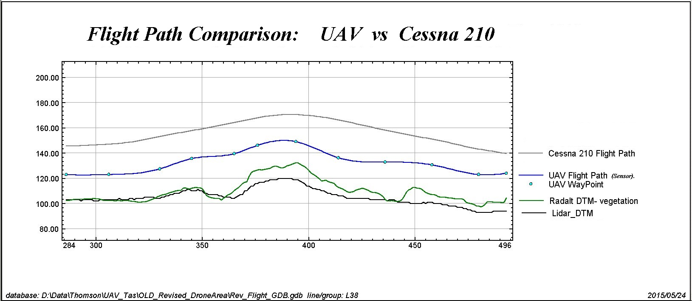
UAV Verses Cessna 210

Slide 23
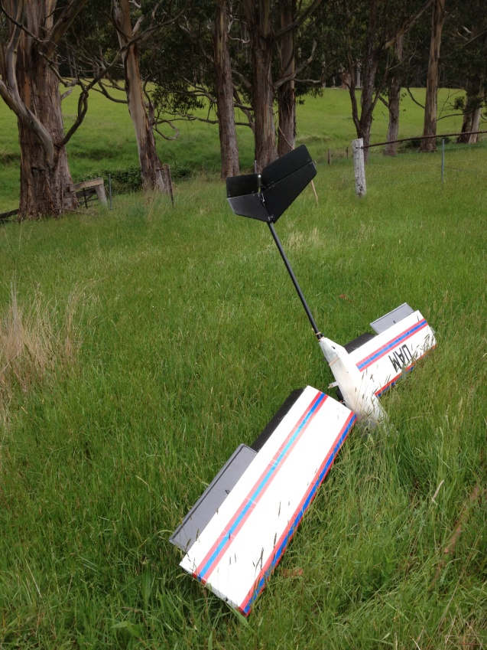
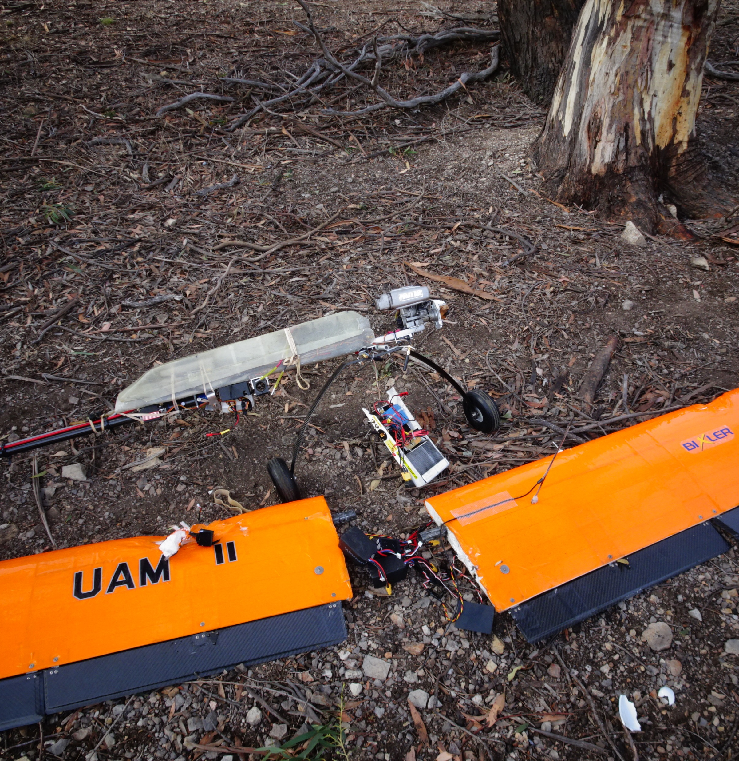
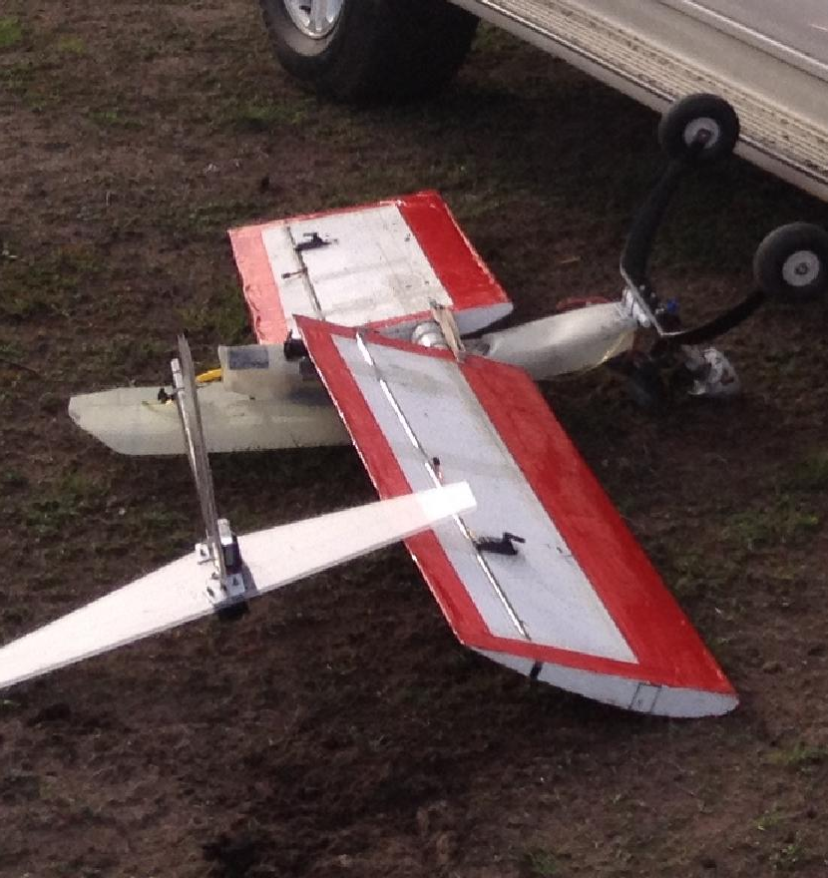
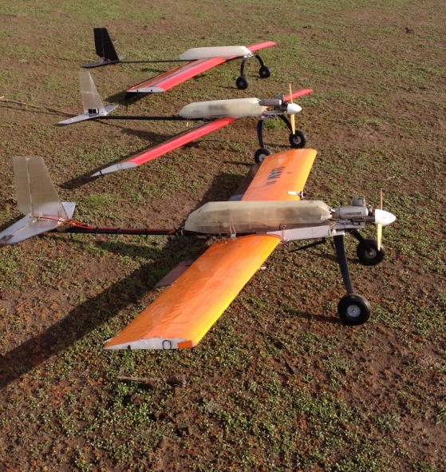
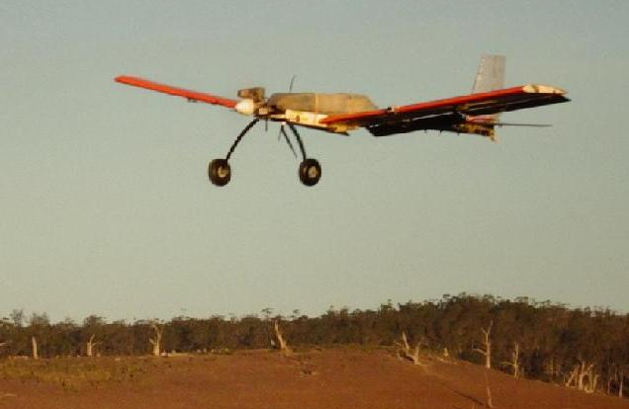
UAV’s do crash……

Slide 24
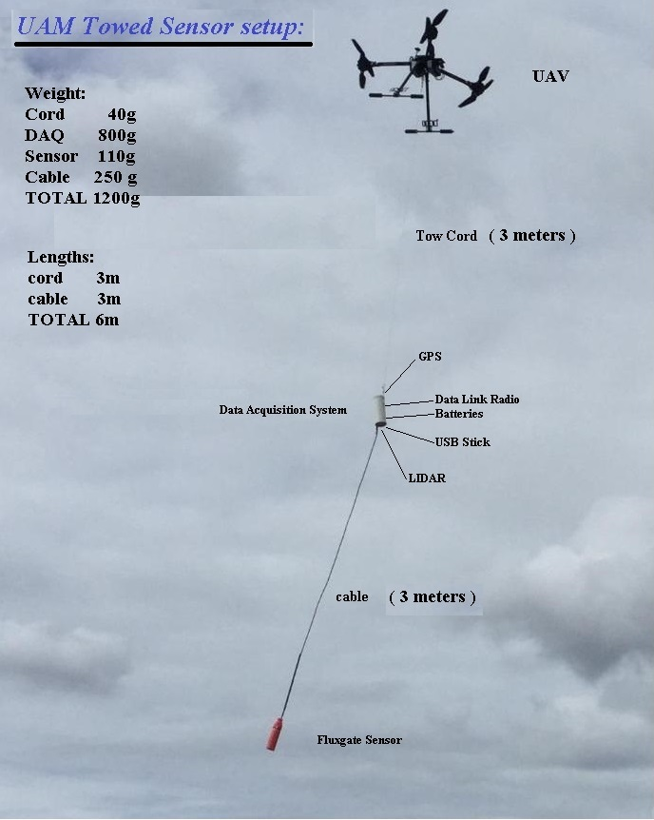
The next phase- Multirotors

Slide 25
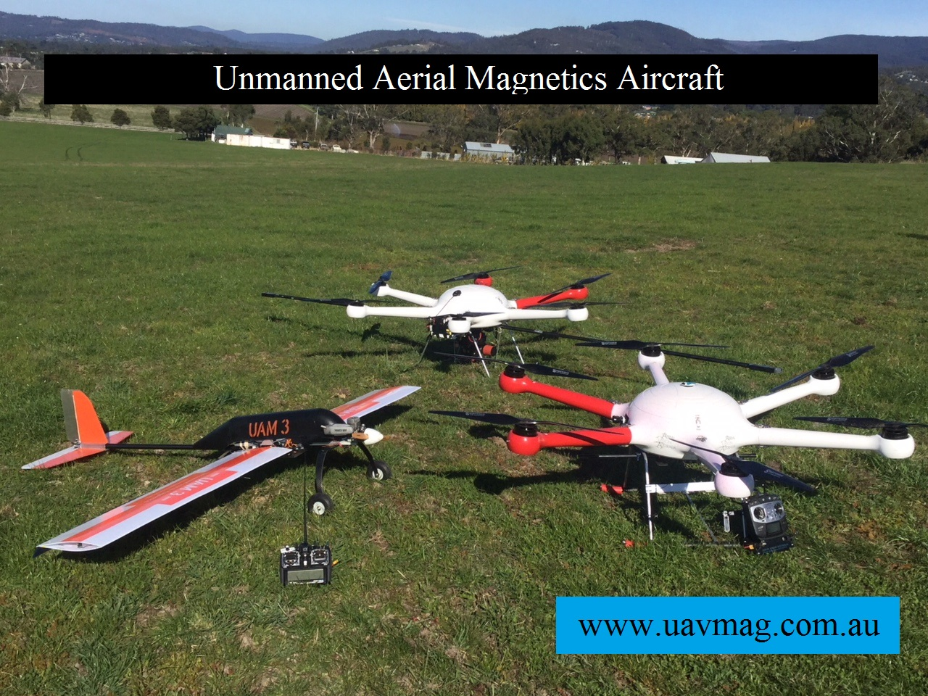
Recent advancements- Hybrid technology

Slide 26
Video of UAV Mag Survey:
Lotta Tasmania 5 min
LIDAR Data supplied
Heavily forested
Relay drone used for communications
Towed Mag bird.

Slide 27
Development of UAV magnetic survey systems:
UAV Hardware Development

Slide 28
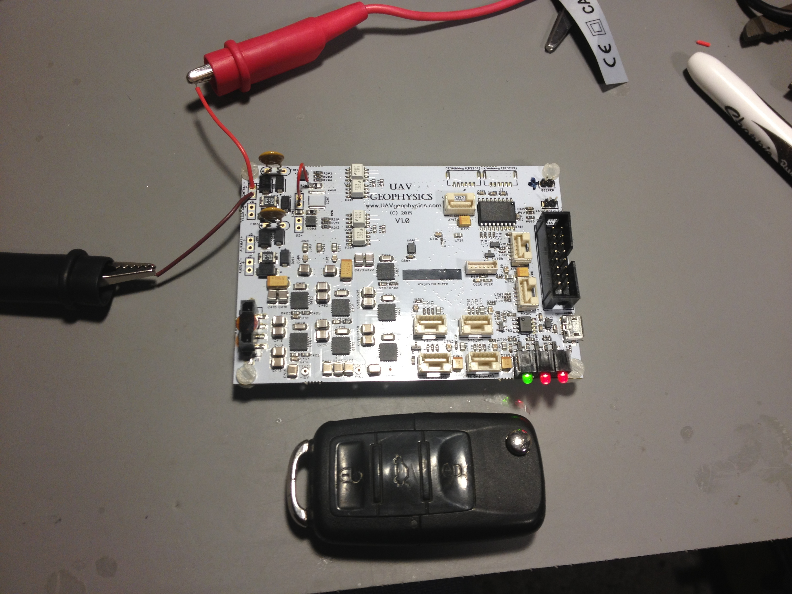
UAV Electronics:
Full Autopilot: Pixhawk
Magnetic fluxgate sensor
Data Acquisition System
LIDAR
Data telemetry to base
Autopilot datalink to base
Full data logging to USB

Slide 29
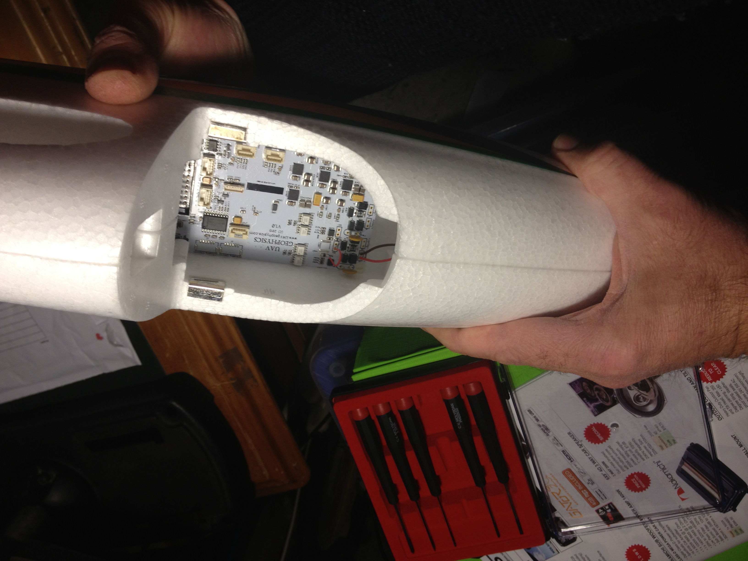
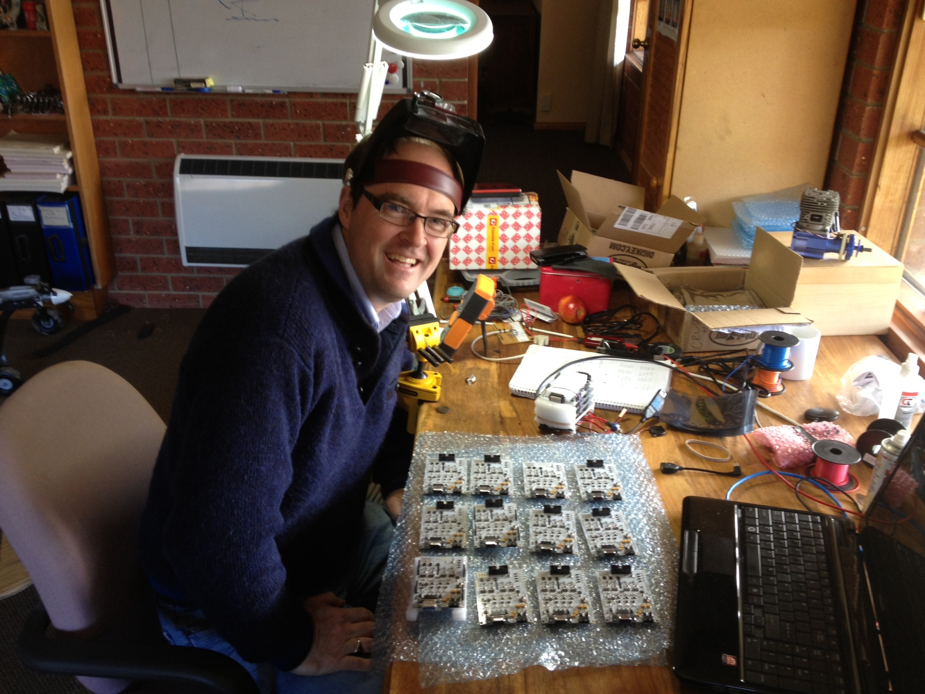
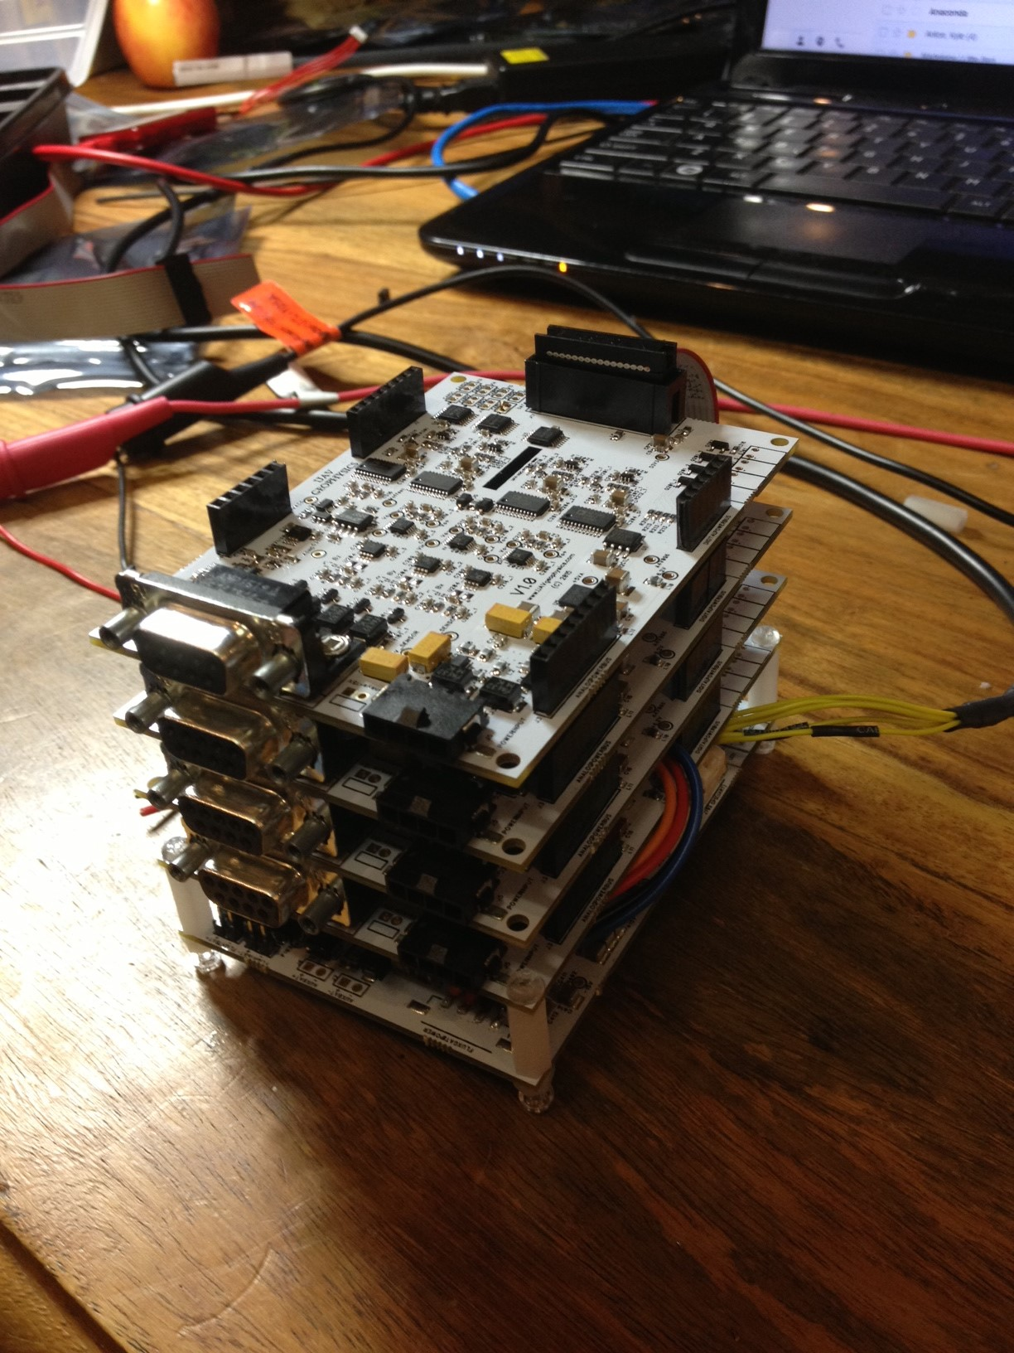
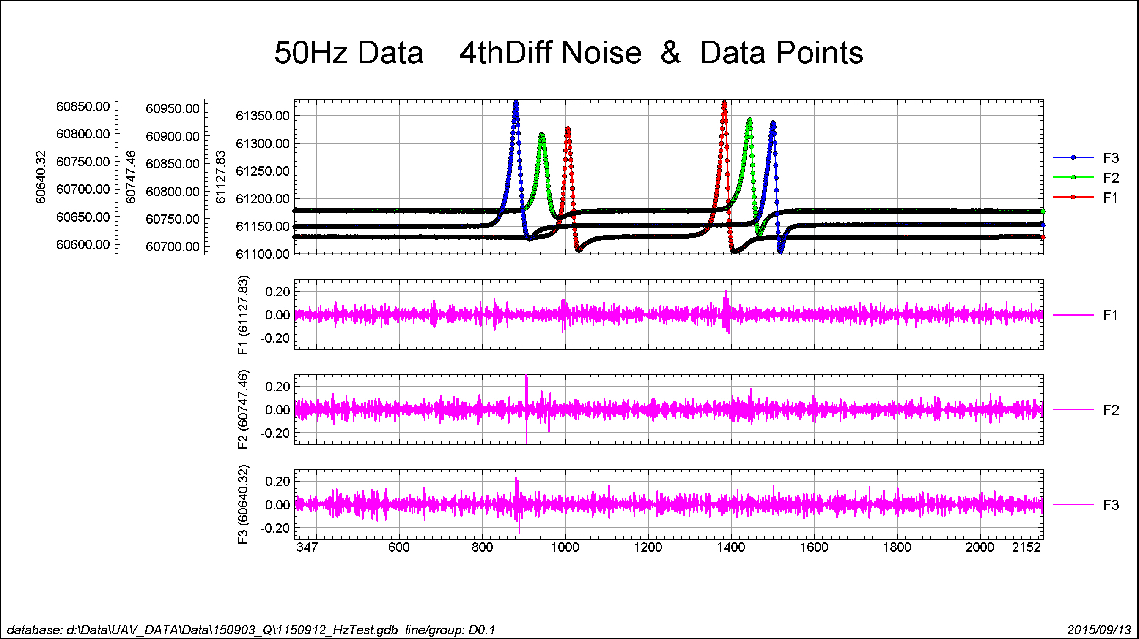
Custom DAQ System:

Slide 30
DATA ACQ SYSTEM:
Sample rate 50Hz
Sample interval 0.4 meters
Sensor 3 Axis high sensitivity Fluxgate
DAQ 24 Bit synchronous ADC
Magnetic Noise Sensor +/- 0.15 nT
Mag Compensation Post processed.
LIDAR 120m Range , accuracy 5cm.
RTK GPS (option) RTK system accuracy 10cm
Standard GPS Ublox M8N 12 Ch Accuracy 2m
DATA MONOTORING Real time data QC at base
Specifications @ May2016

Slide 31
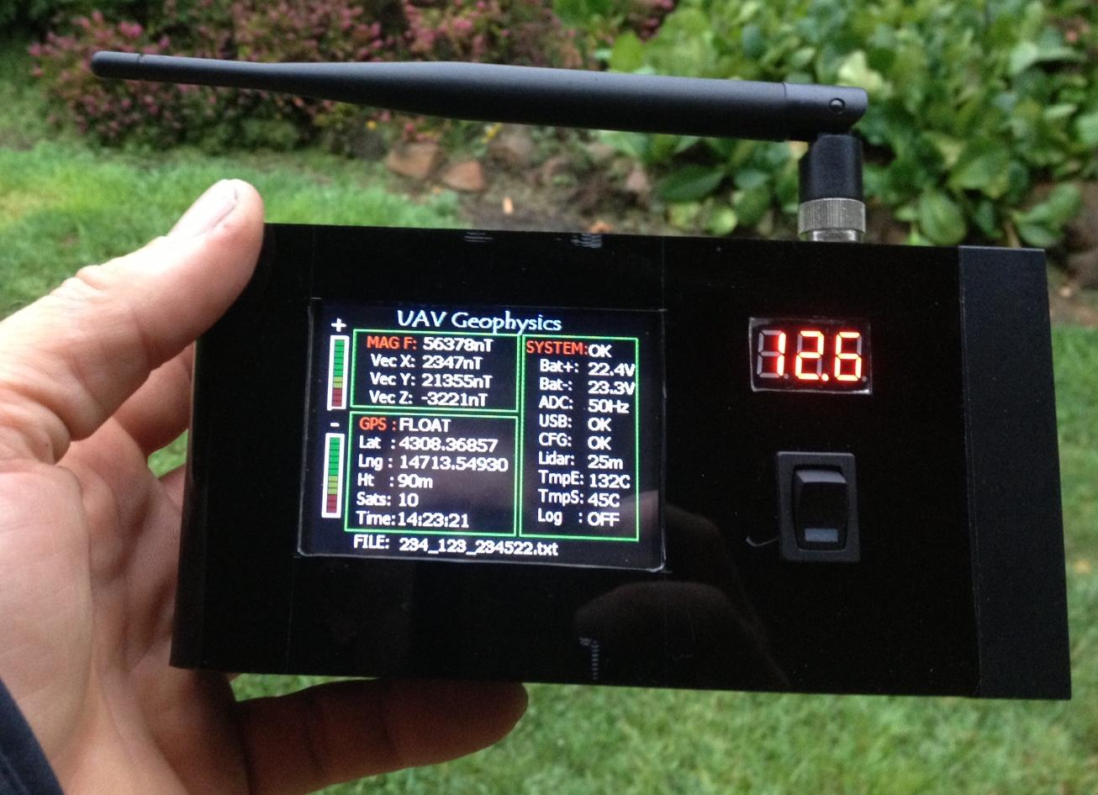
SYSTEM REMOTE DATA QC:
Data Telemetry to ground:
Magnetic data
GPS Location
Number of Satellites
Lidar Height
Battery Voltages
Engine Temperature
Electronics Temperature
Logging Status

Slide 32
Video of UAV Mag Survey:
Karratha 4 min
700 km
Stage1 photogrammetry
Stage2 UAV Mag survey.

Slide 33
Development of UAV magnetic survey systems:
UAV Hardware Development
Magnetometers.

Slide 34
Development of UAV magnetic survey systems:
Magnetometer Selection:

Slide 35
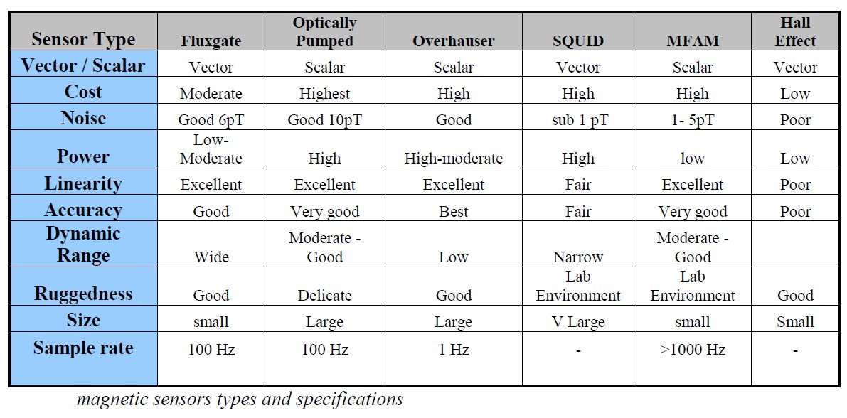
Development of UAV magnetic survey systems:
Magnetic Sensor Comparison:

Slide 36
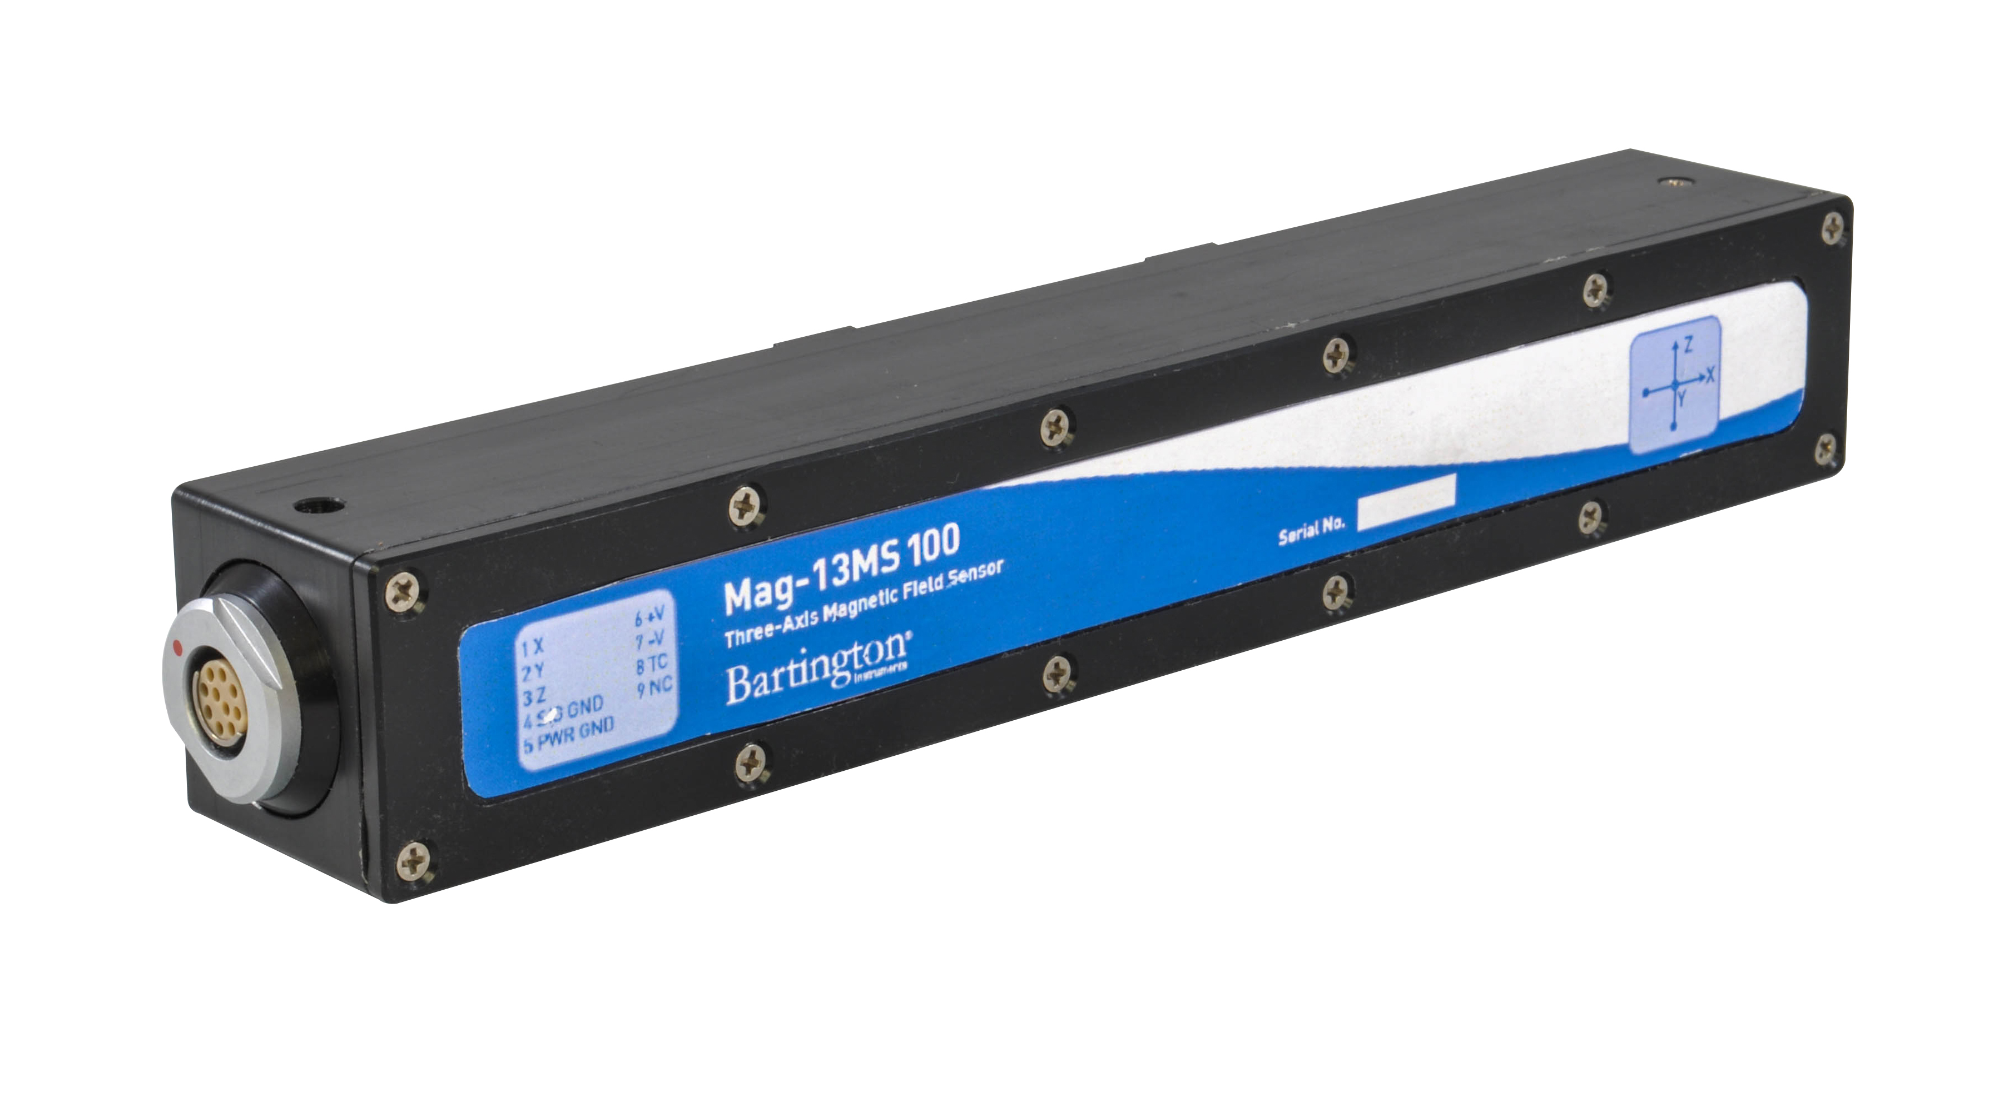
Development of UAV magnetic survey systems:
MFAM Sensor
Fluxgate sensor

Slide 37
Development of UAV magnetic survey systems:
Magnetic Noise:
The survey data is the final product, and good data quality is essential. UAV Magnetic data quality is affected by the following sources:
Sensor internal noise
Data Acquisition noise
EMI interference
Permanent magnetic interference
Induced magnetic interference
Eddie current magnetic interference
These noise sources are derived from:
Sensor and recording system.
Engine
Servos
Aircraft movement
Sensor movement
Conductive materials
Radio/ video transmitters

Slide 38
Magnetic compensation
Must remove effects of movement
Interference of aircraft and other sources.
--Fluxgate responses due to Roll, Pitch Yaw of sensor.

Slide 39
Magnetic compensation
Must remove effects of movement
-Profiles of maneuver noise

Slide 40
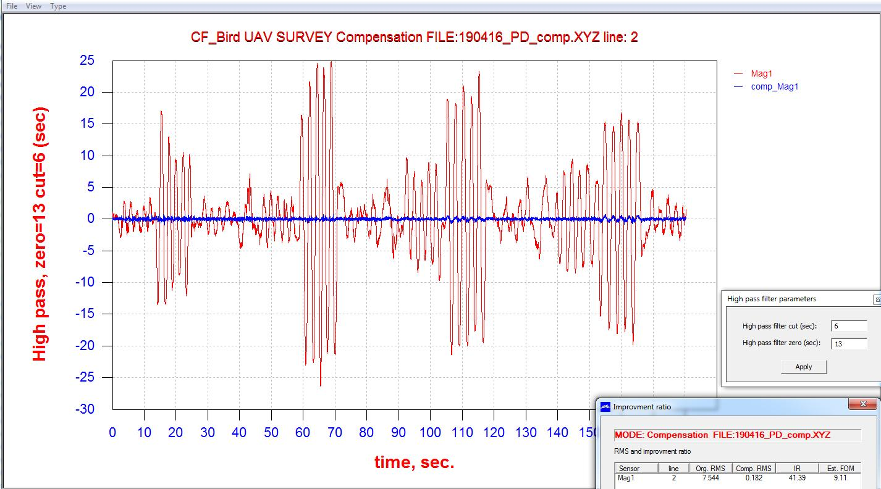
Magnetic compensation
-Post processed Magnetic compensation.
-Typical residual noise < 0.4 nT per maneuver.

Slide 41
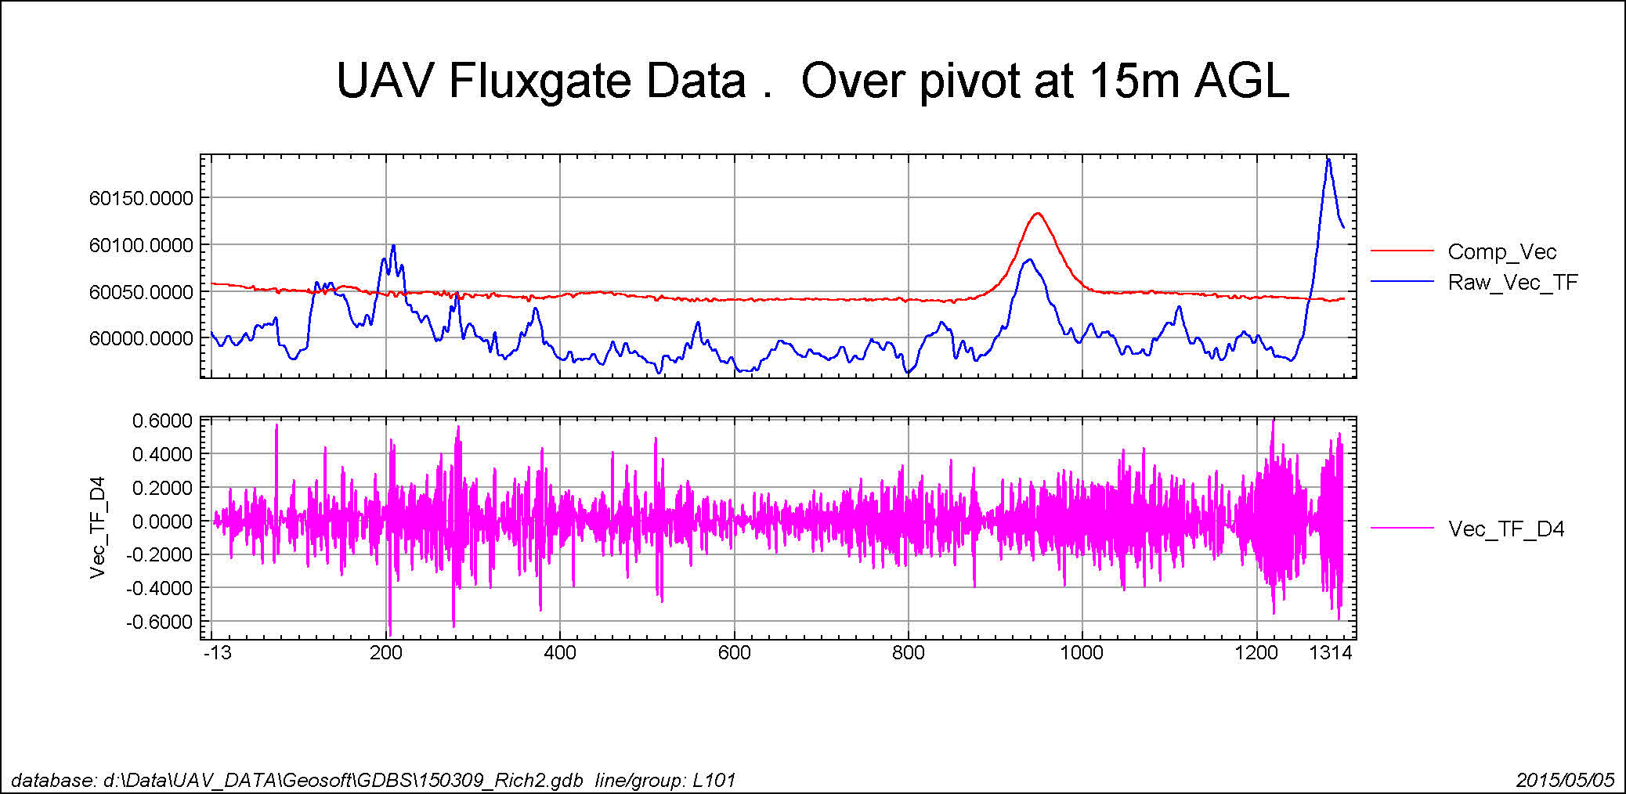
Mag Compensation profile
Example Magnetic profile over irrigation pivot at 15m AGL
Raw Mag vs Compensated Mag profile.
4th Diff Noise online < +/- 0.2 nT

Slide 42
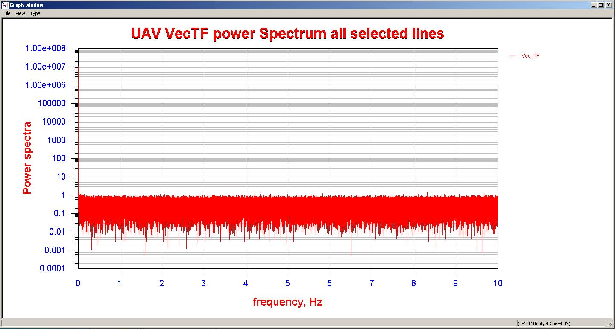
Magnetic data Power Spectrum:
Power spectrum of Magnetic data shows no Harmonics or interference effects from UAV electronics.

Slide 43
Video of UAV Quarry Survey 2 min
150 km Rugged terrain
Trying to define intrusive sections in Limestone
Over a working Quarry

Slide 44
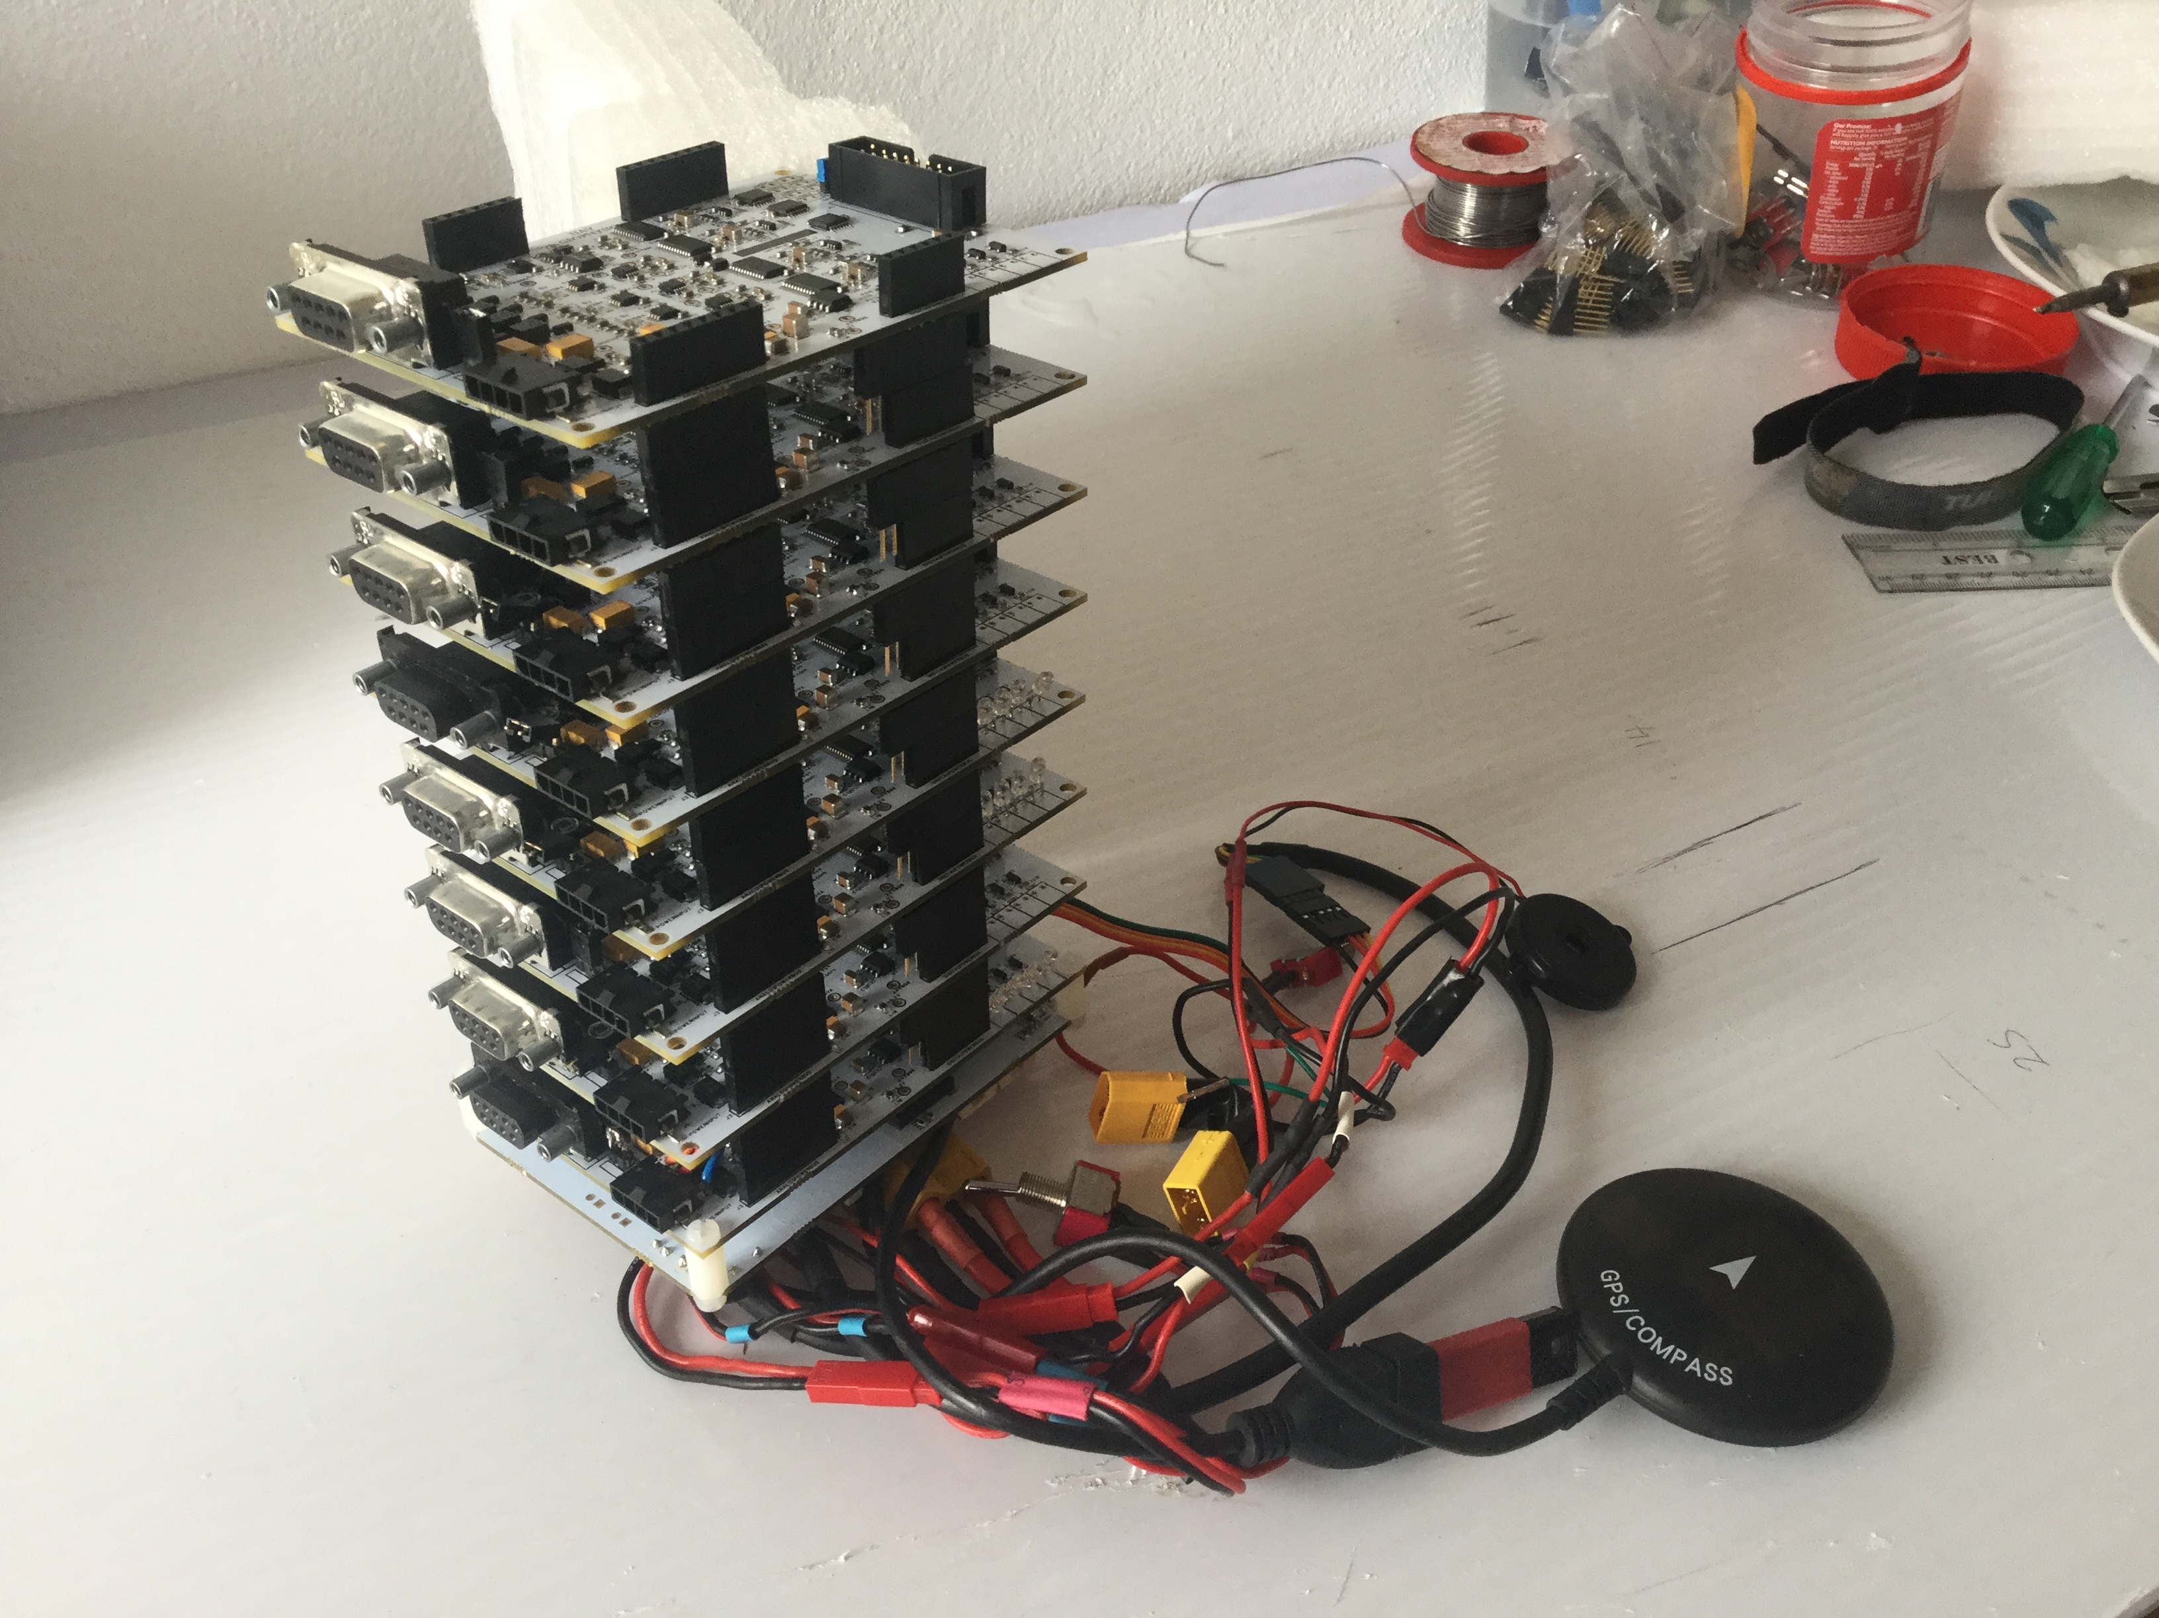
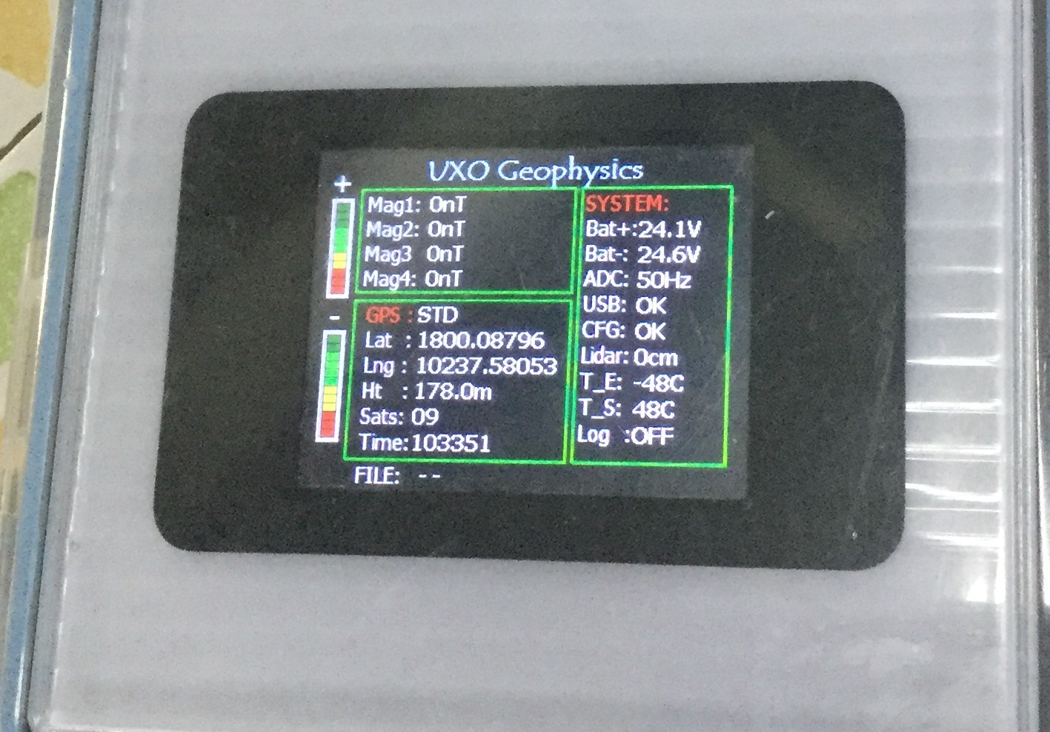
UXO Detection - DAQ

Slide 45
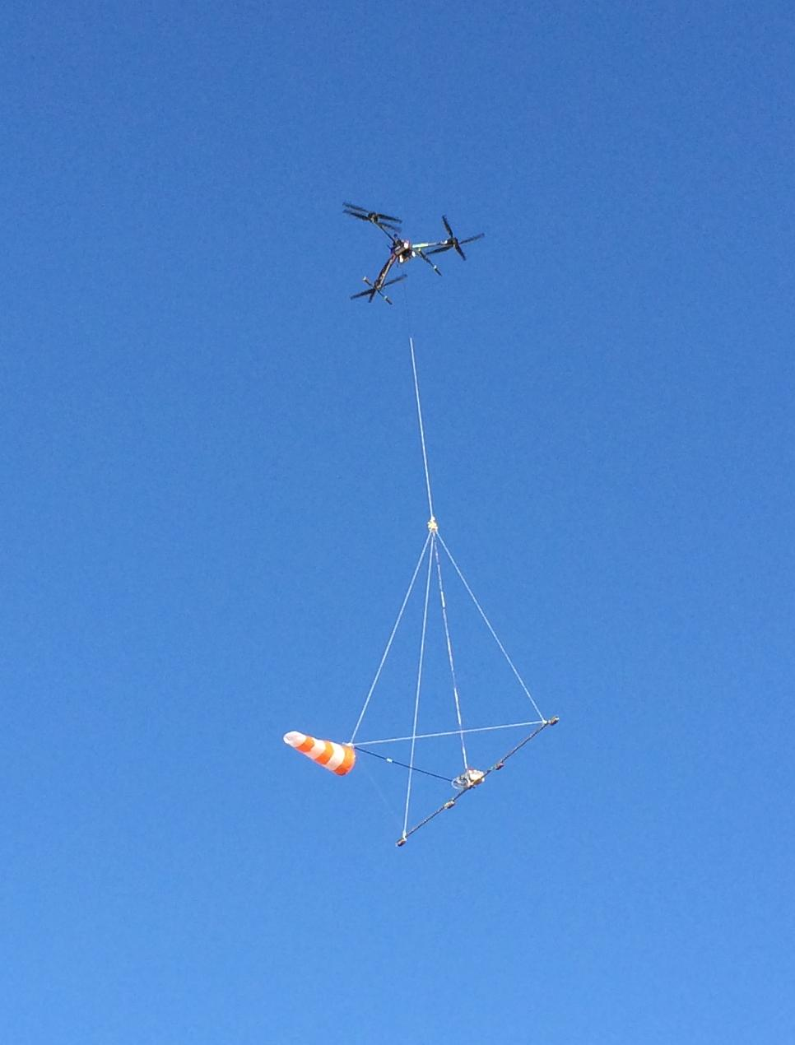
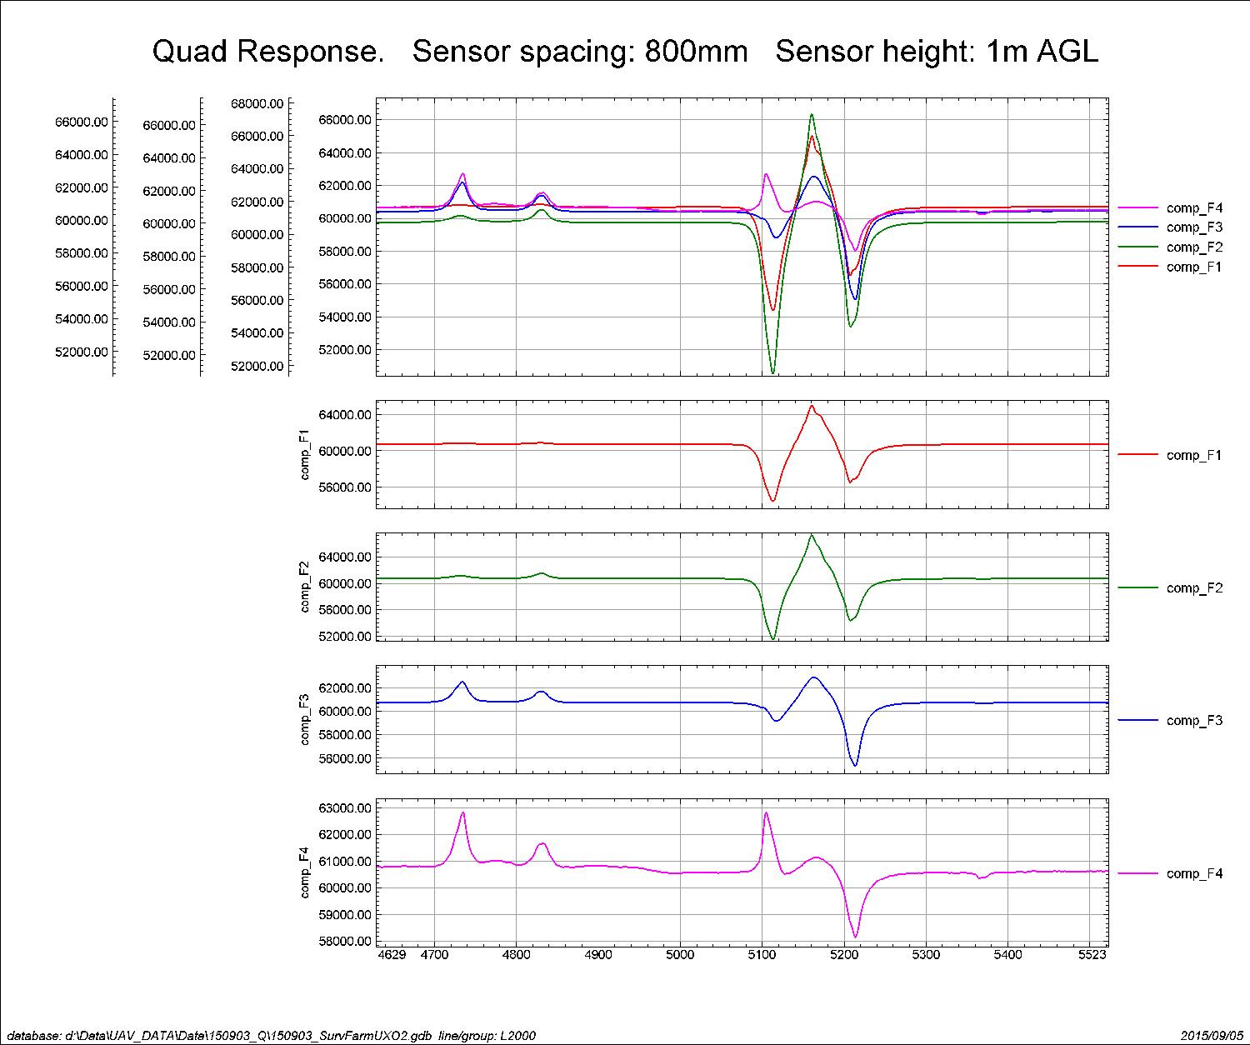
Quad sensor on UAV

Slide 46
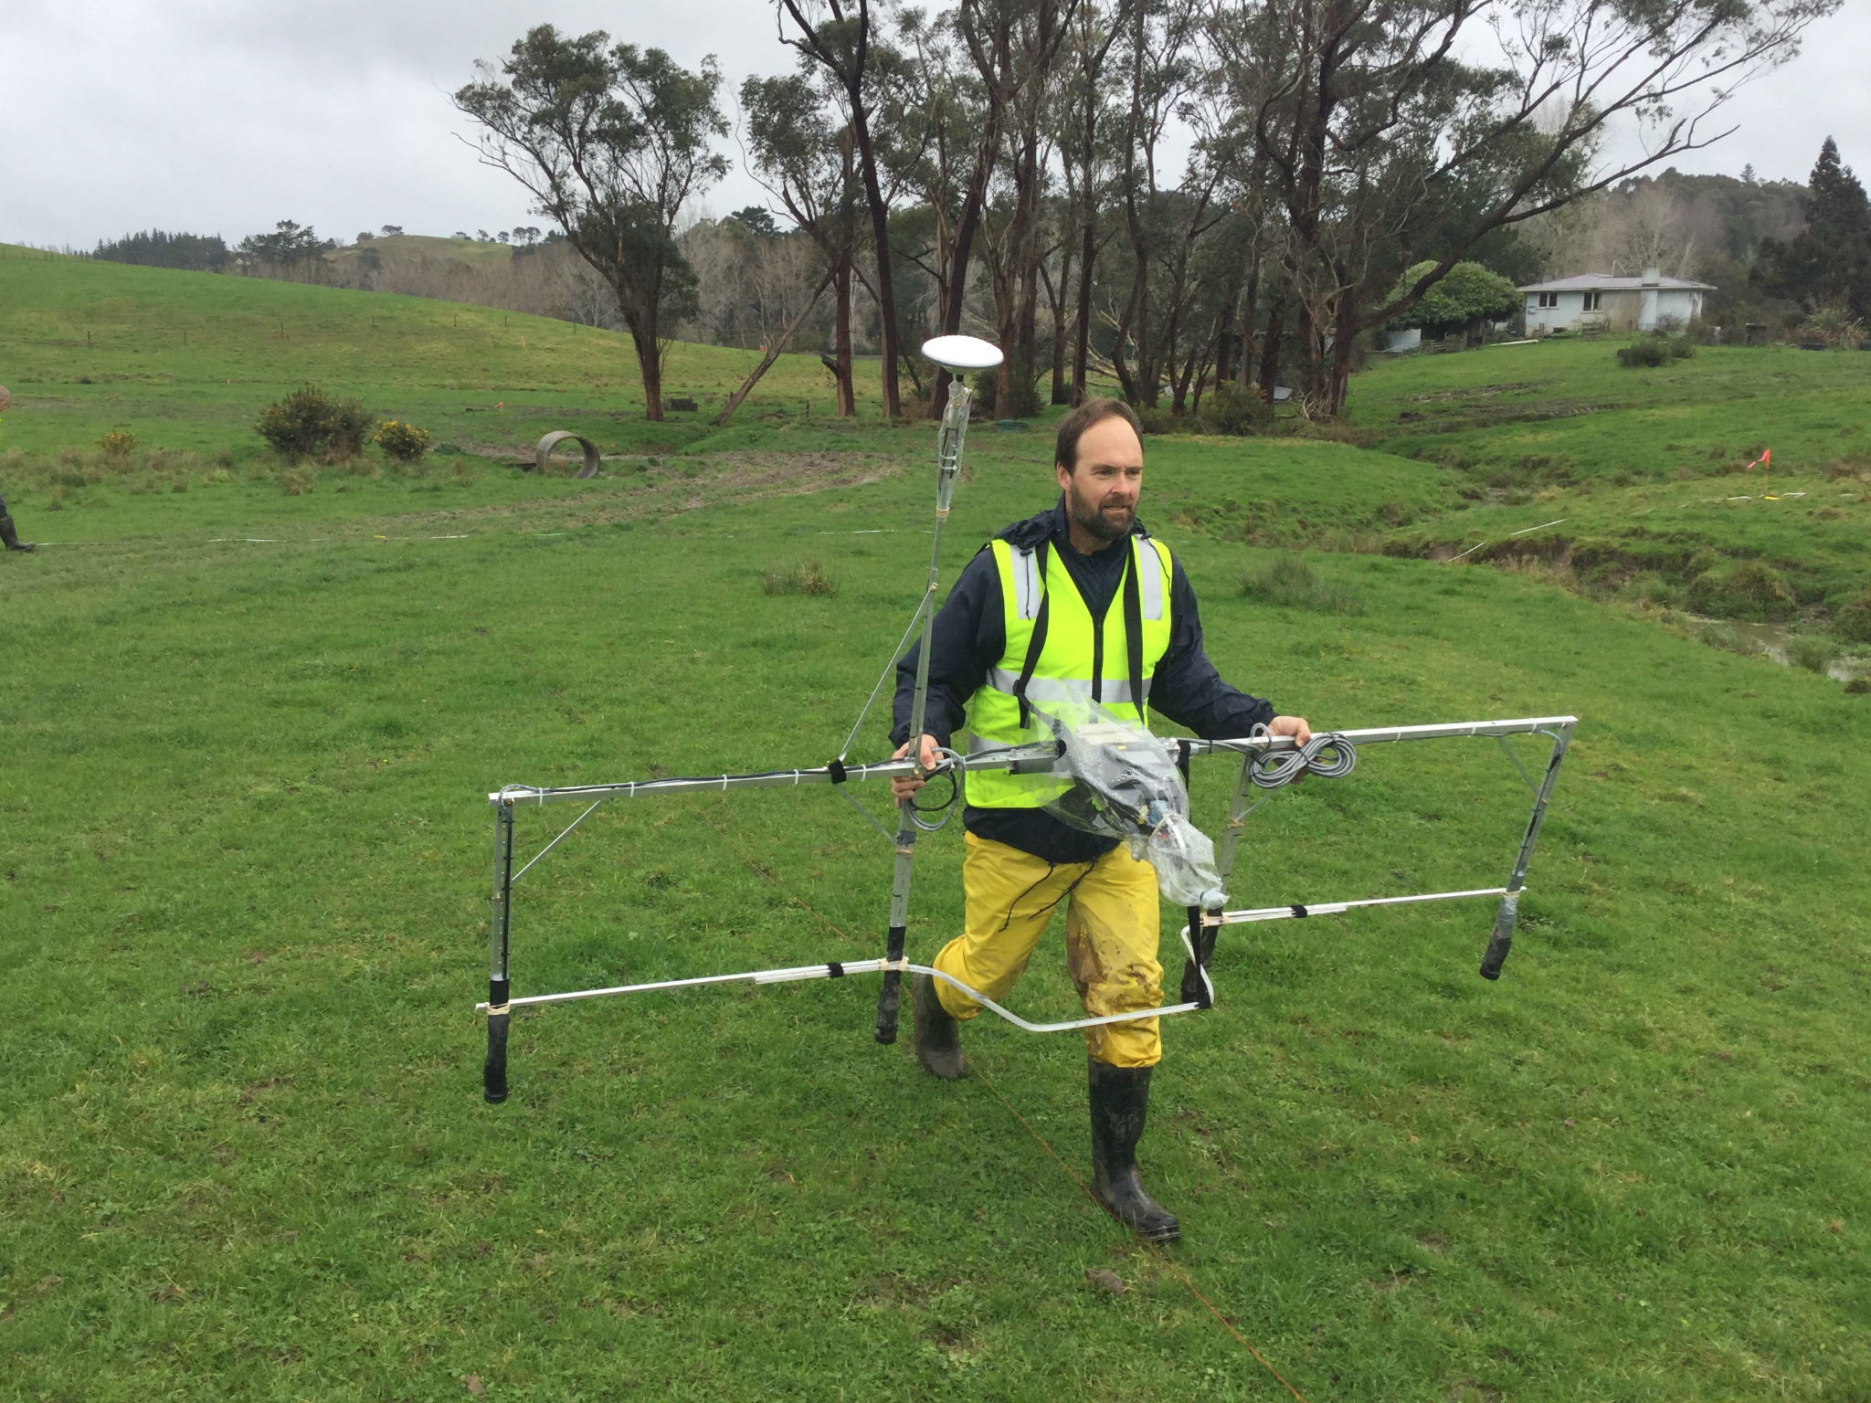
4 sensor Walking UXO detection system

Slide 47
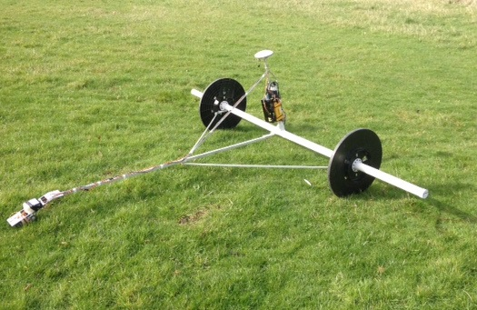
6 sensor UXO towed cart

Slide 48
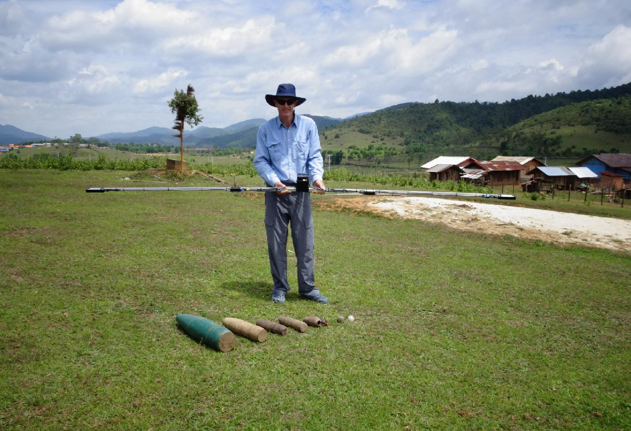
LAOS- 4 sensor UXO Boom -light weight

Slide 49
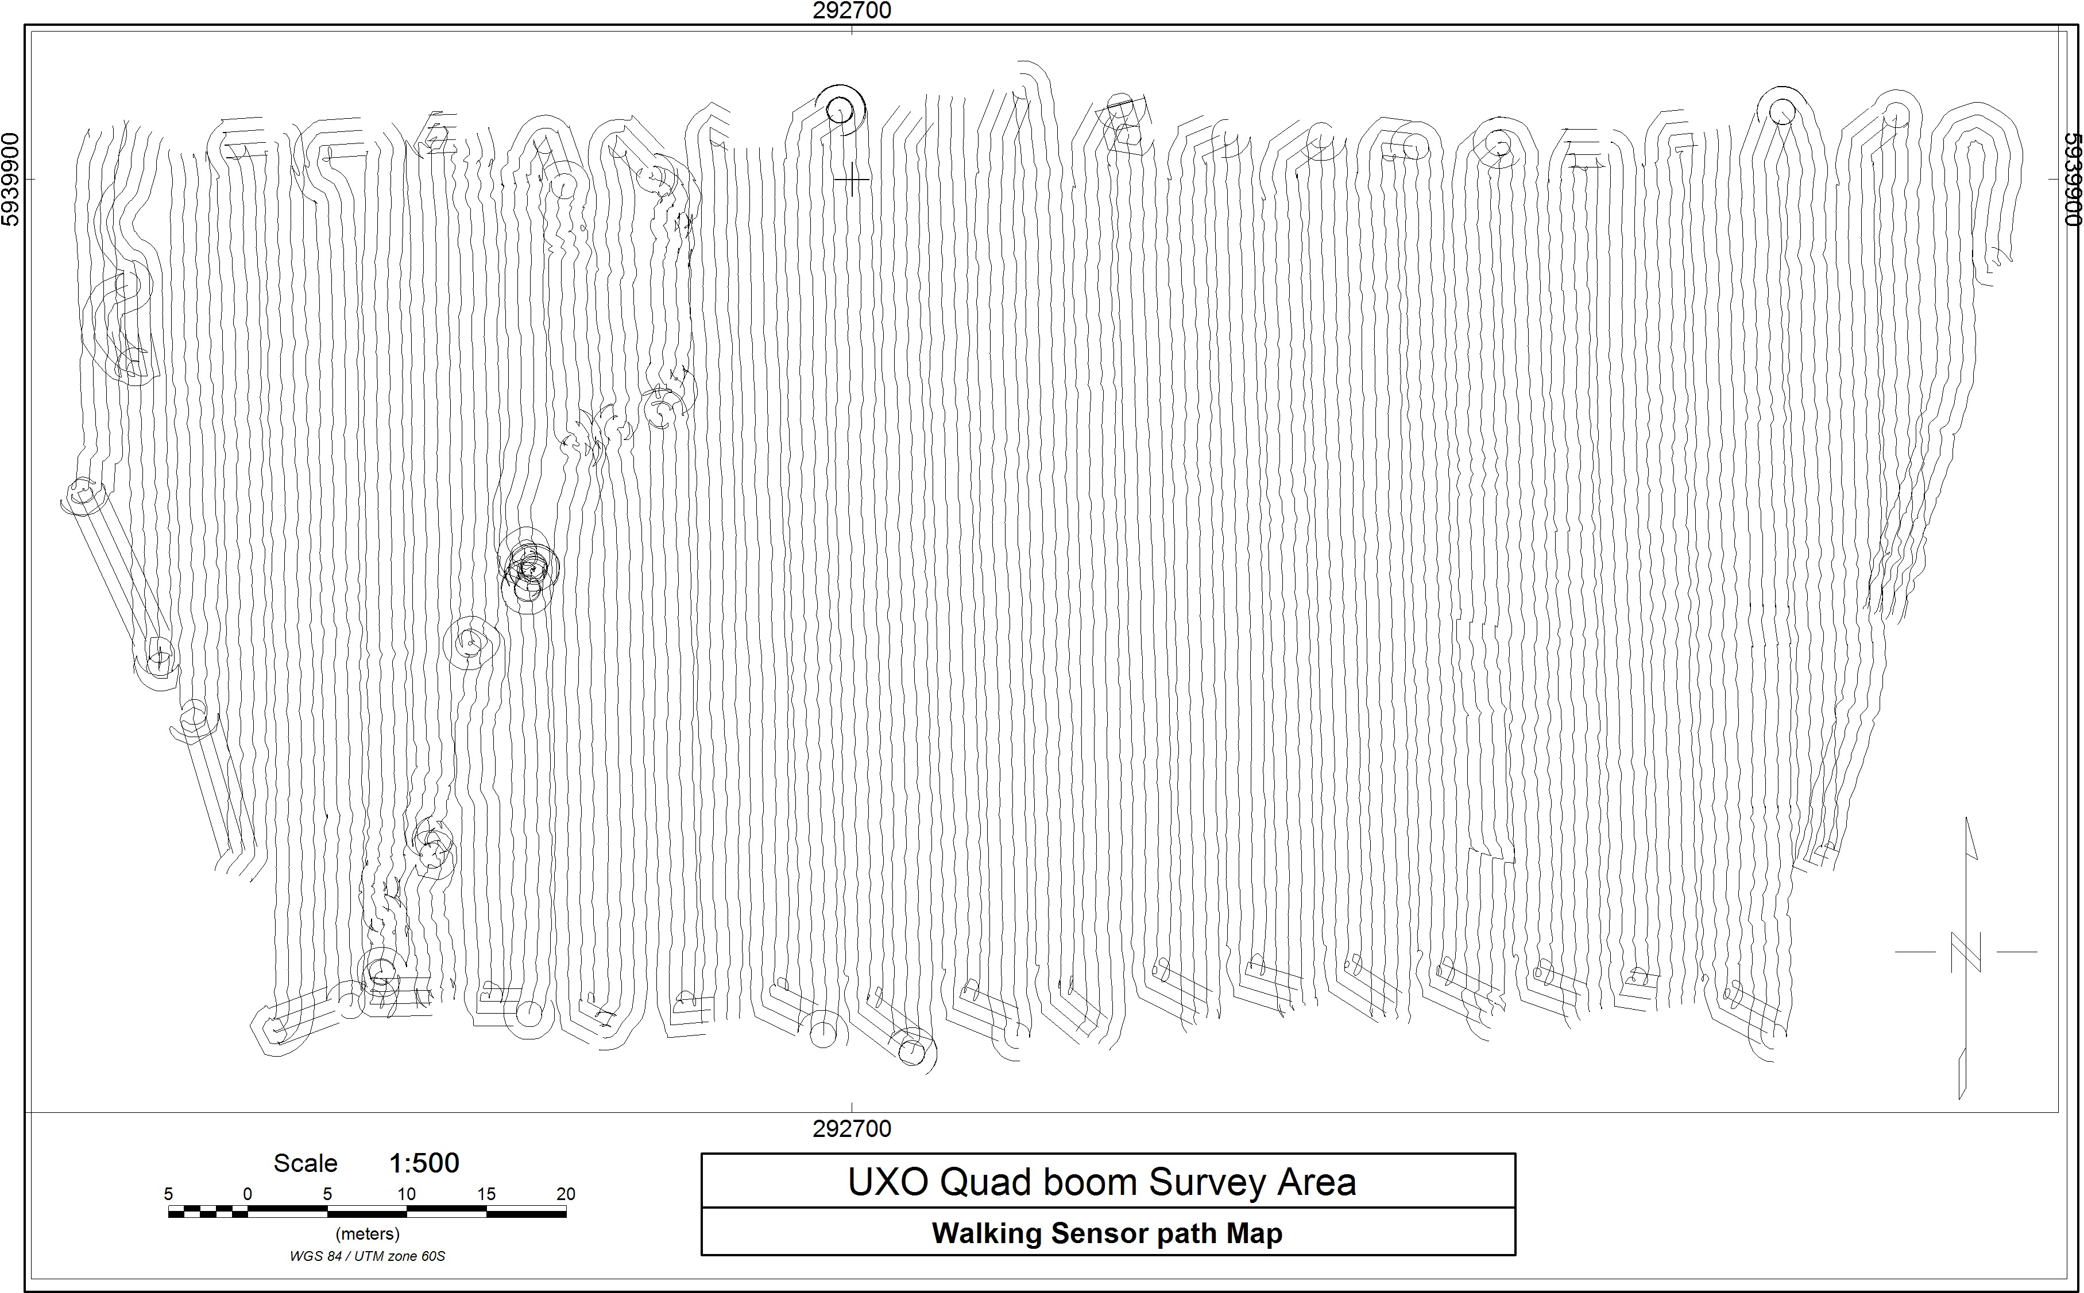
UXO Quad Boom coverage Map

Slide 50
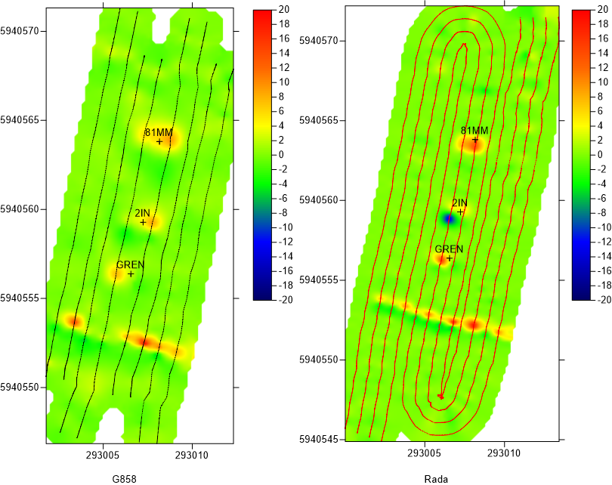
4 Sensor results

Slide 51
Quad sensor
UXO detector on UAV

Slide 52
Video of UAV Coal Survey2 min
1000 km Flat terrain
Trying to define intrusive Dykes
Structures in coal.

Slide 53
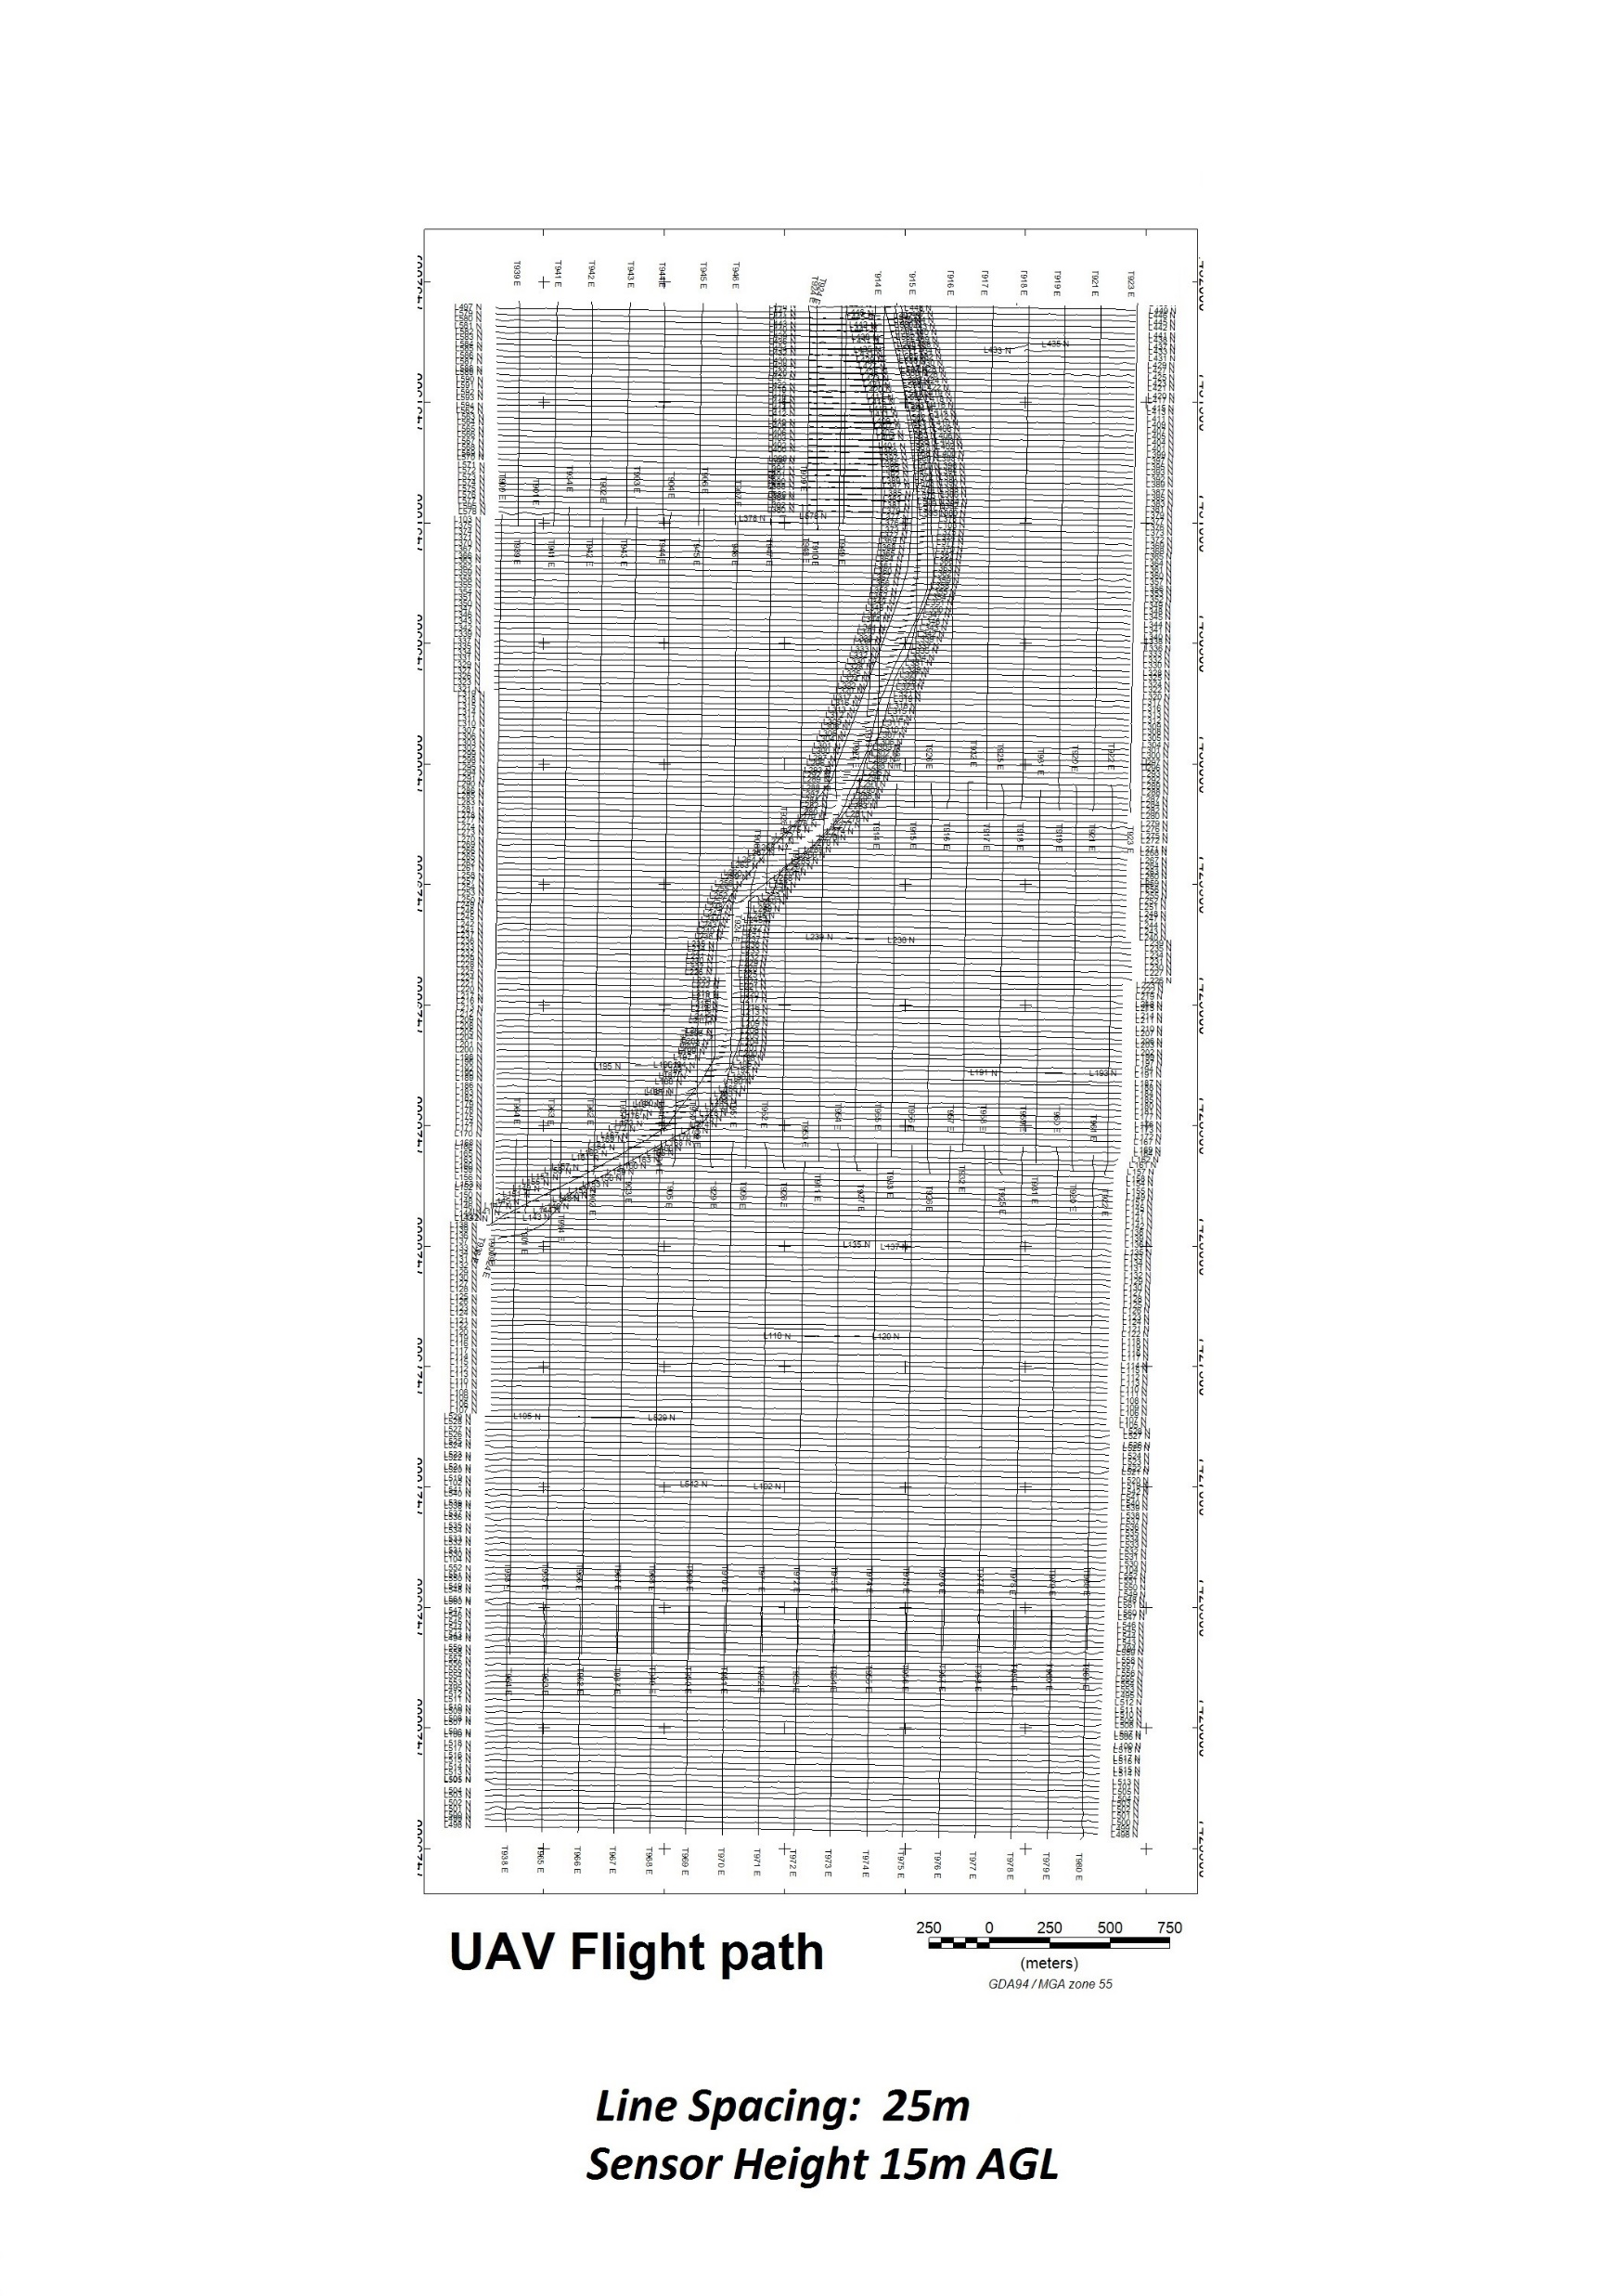
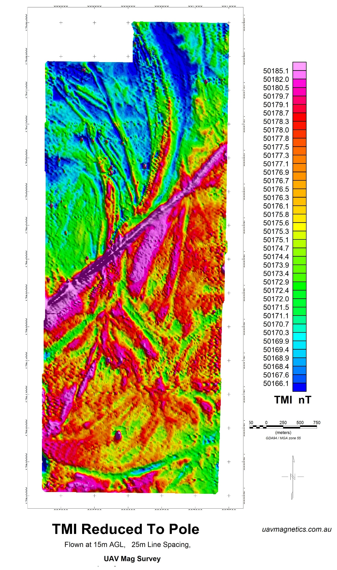
UAV Coal survey Mag Data :

Slide 54
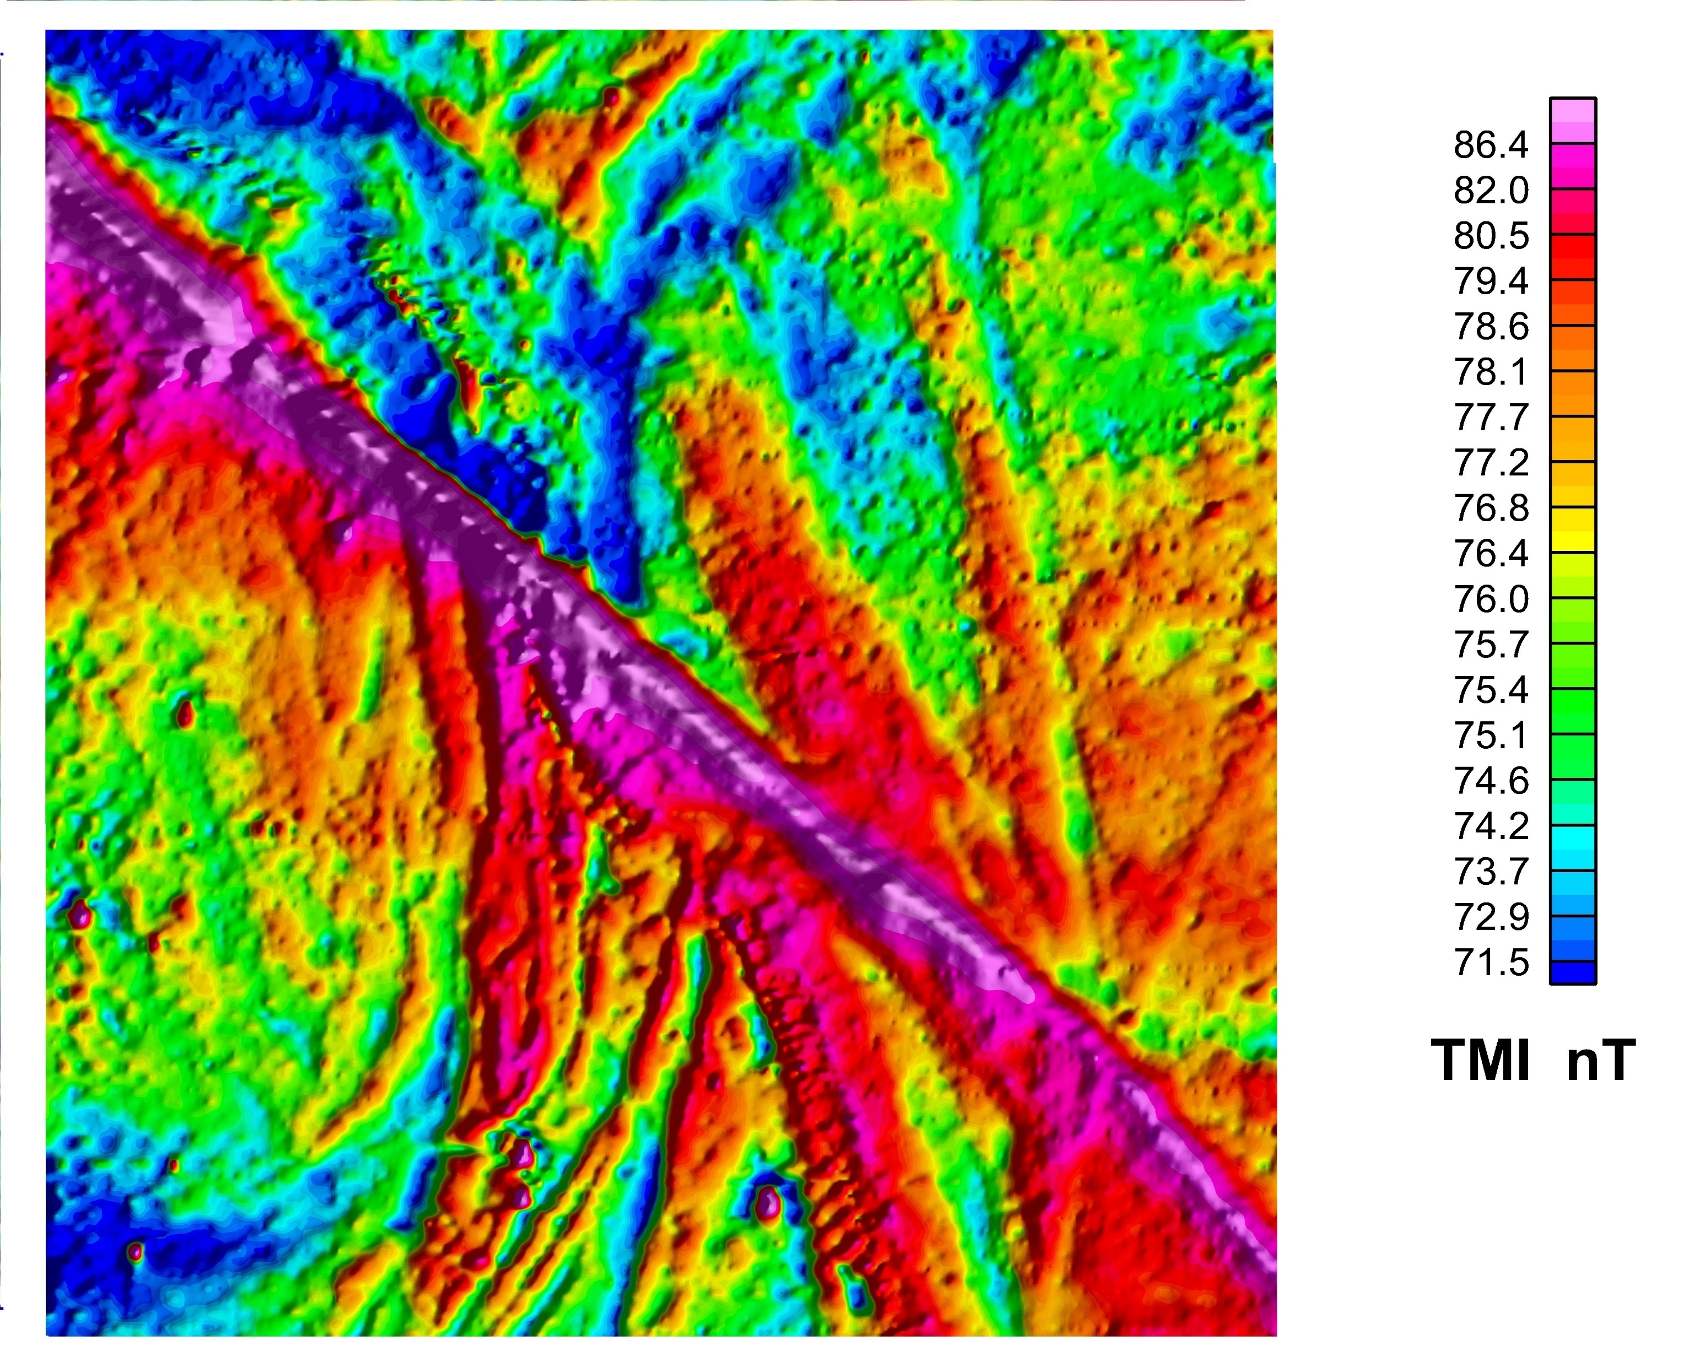
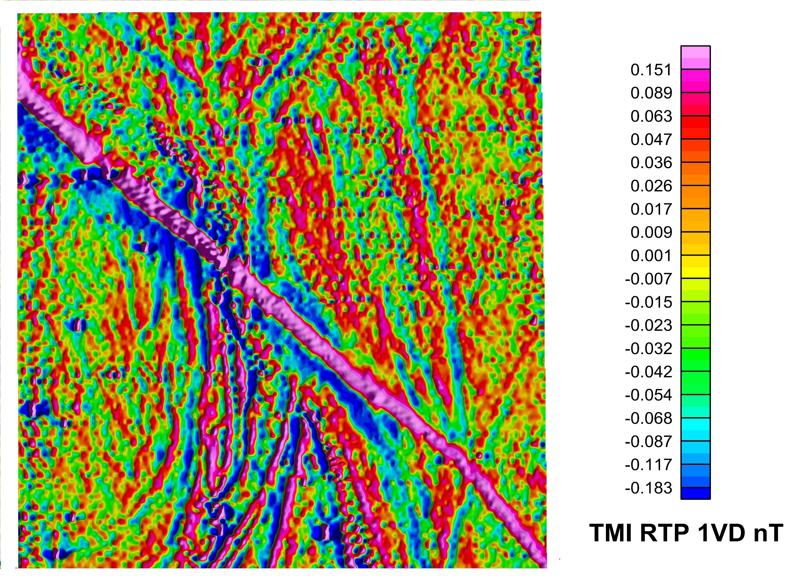
UAV Coal Survey Data:

Slide 55
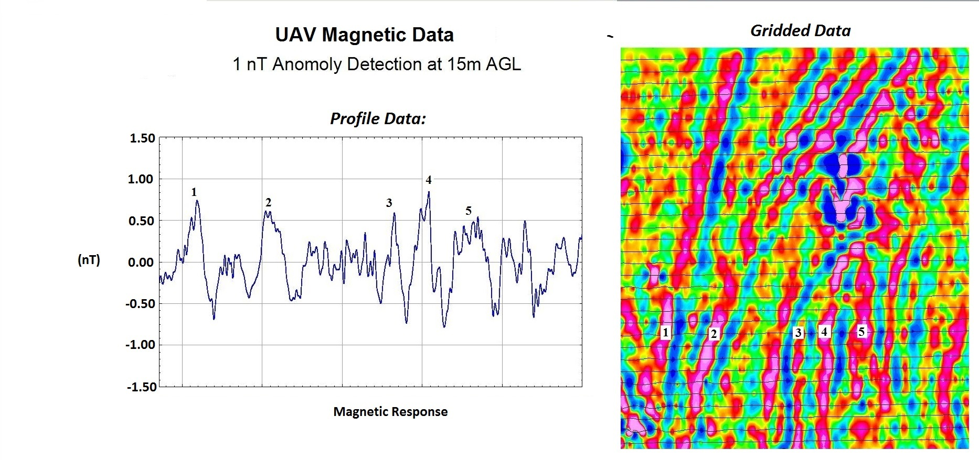
UAV Coal Survey data

Slide 56
THE END…
But really just the beginning of a new phase of exciting technology.

